Slide 1
Statistics and R short course
Session 3: Probability distributions Marc Henrion, Evaristar Kudowa

Slide 2
Introduction

Slide 3

Preliminaries
Certificates of attendance
You need to attend all 6 sessions.
Sign in & check spelling of name on the sign-in sheet!
Only issued if paid-up and in exchange for completed feedback form.
Office hours
Vester - Mondays @ 2pm; Kapeni Meeting 1
Eva - Tuesdays @ 2pm; Creator Ground Floor
Marc - Thursdays @ 9am; Kapeni Meeting 2
Jessie - Mondays @ 3pm; Kapeni Hurdle 1
Housekeeping
Refreshments (no lunch - sorry)
Fire exits & bathrooms

Slide 4
Learning outcomes
KNOW R: Explain know what R is & what it can do.
KNOW R RESOURCES: List useful R resources and access them.
DO R: Perform basic operations relevant for your research in R:
Read data into R & write data or results to the harddrive.
Manipulate & use different object types.
Write & use functions in R
Perform basic analyses on a dataset: mean, standard deviation, linear regression.
Produce various standard graphs and tables
UNDERSTAND BASICS OF STATISTICS: Explain basic statistical theory: common distributions, standard statistical techniques, common study designs, assumptions behind common statistical tests and regression models.
UNDERSTAND STUDY DESIGNS: Recommend appropriate designs & analyses.
COMPREHEND OPEN SCIENCE: Summarise principles of open, reproducible research.
DO OPEN SCIENCE WITH R: Use R scripts, R markdown, packages & GitHub.

Slide 5

Preliminaries
https://github.com/mlw-stats/R_And_Statistics_Training_2026

Slide 6
Probability theory

Slide 7

Quantifying uncertainty

Slide 8
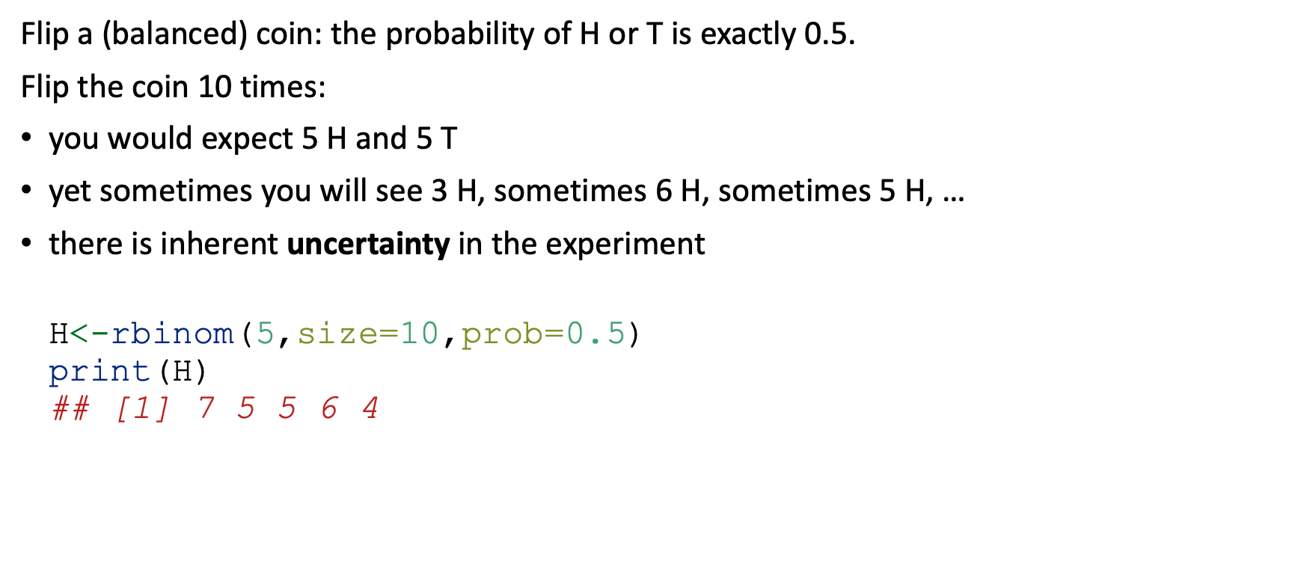
Statistics & uncertainty
Flip a (balanced) coin: the probability of H or T is exactly 0.5.
Flip the coin 10 times:
you would expect 5 H and 5 T
yet sometimes you will see 3 H, sometimes 6 H, sometimes 5 H, …
there is inherent uncertainty in the experiment
H<-rbinom(5,size=10,prob=0.5) print(H) ## [1] 7 5 5 6 4

Slide 9
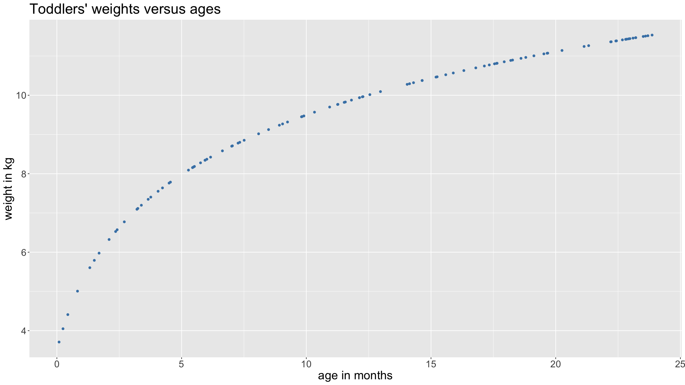
Statistics & uncertainty
Suppose weight was a deterministic function of a toddler’s age: you start off at 3.5kg, and then your weight follows a logarithmic curve until age 24 months at which point you reach 11.5kg.
This is obviously not what happens in real life (though an OK approximation for US girls).
ageMonths<-runif(100,min=0,max=24) # sample some random ages weight<-3.5+2.5*log(ageMonths+1) # compute the weights dat<-tibble(ageMonths,weight) dat %>% ggplot(mapping=aes(x=ageMonths,y=weight)) + geom_point(color="steelblue")
+ xlab("age in months") + ylab("weight in kg") + ggtitle("Toddlers' weights versus ages") + theme(text = element_text(size=20))

Slide 10
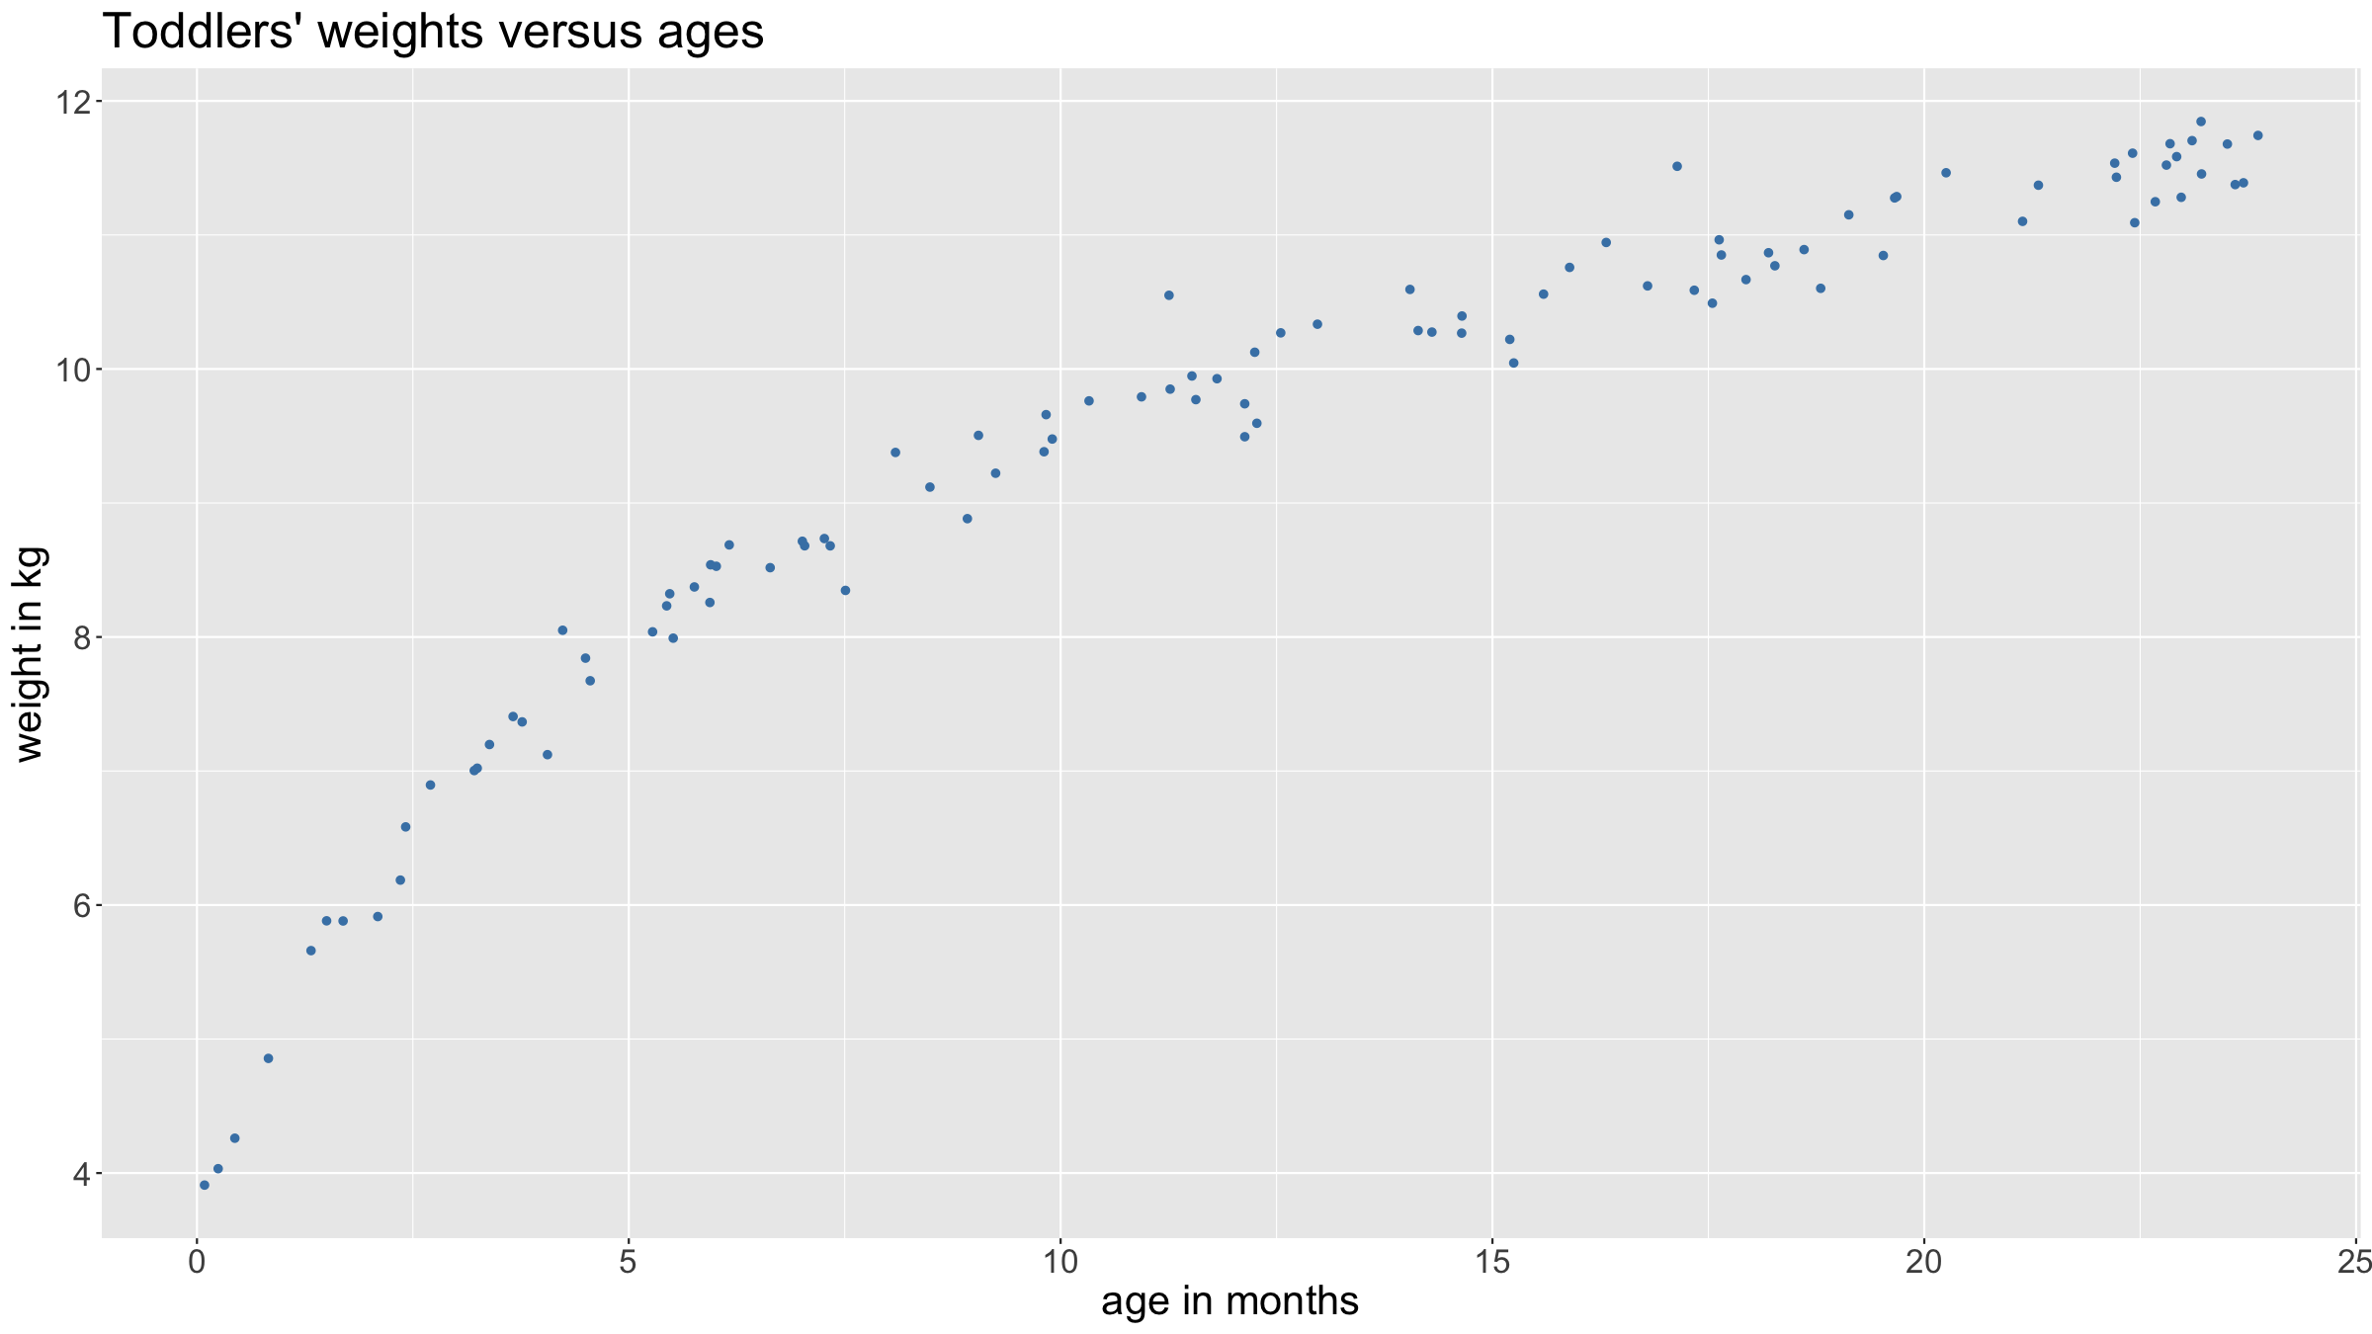
Statistics & uncertainty
Now suppose when we measure a toddler’s weight, the accuracy of our measurement is not perfect: each time we record a slightly different value than the true one, though on average we get it right.
dat<-mutate(dat,weightWithError=rnorm(nrow(dat),mean=weight,sd=0.25)) dat %>% ggplot(mapping=aes(x=ageMonths,y=weightWithError)) + geom_point(color="steelblue") + xlab("age in months") + ylab("weight in kg") + ggtitle("Toddlers' weights versus ages") + theme(text = element_text(size=20))

Slide 11
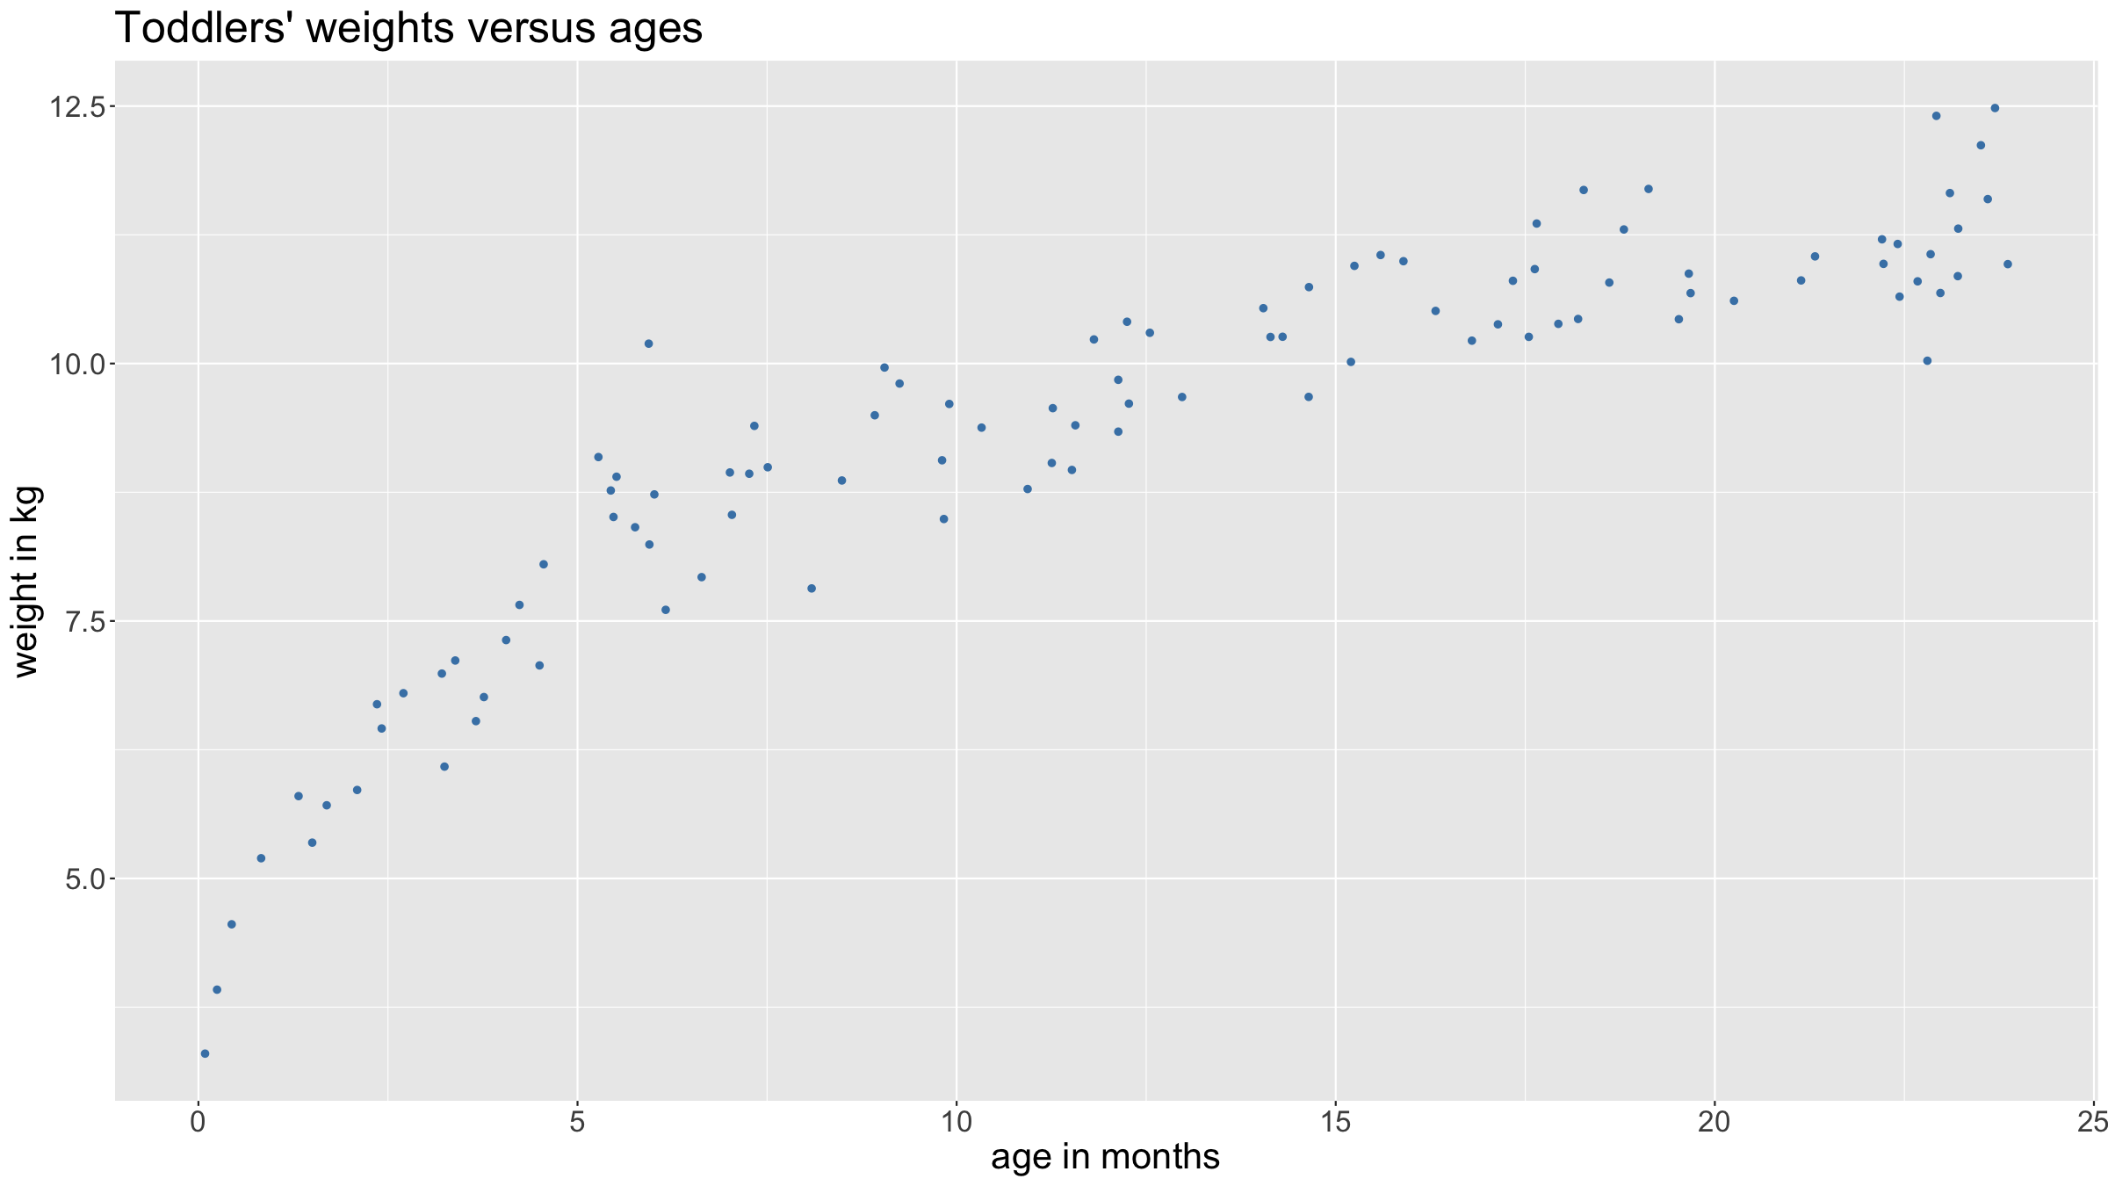
Statistics & uncertainty
Now suppose we can measure weights perfectly again. But now suppose that there are unobserved characteristics (e.g. genetic factors, nutritional status, …) that impact on children’s weights.
dat<-dat %>% mutate(latentFactor1=rnorm(nrow(dat),mean=0,sd=0.5)) %>% mutate(latentFactor2=rnorm(nrow(dat),mean=0,sd=0.1)) %>% mutate(weightGivenLatentFactors=3.5+latentFactor1+(2.5+latentFactor2)*log(ageMonths+1)) dat %>% ggplot(mapping=aes(x=ageMonths,y=weightGivenLatentFactors)) + geom_point(color="steelblue") + xlab("age in months") + ylab("weight in kg") + ggtitle("Toddlers' weights versus ages") + theme(text = element_text(size=20))

Slide 12
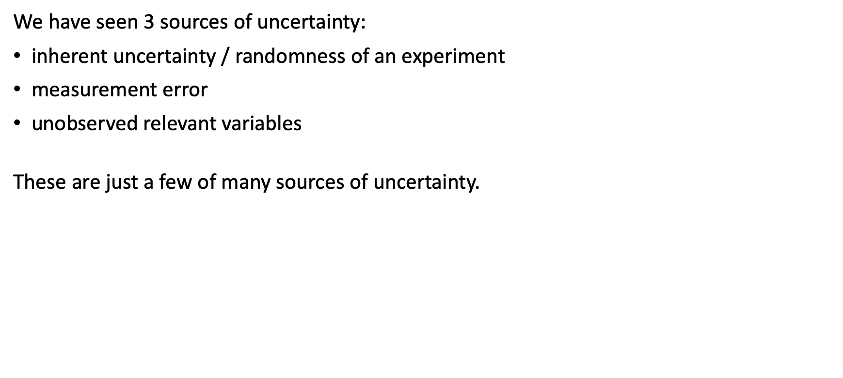
Statistics & uncertainty
We have seen 3 sources of uncertainty:
inherent uncertainty / randomness of an experiment
measurement error
unobserved relevant variables
These are just a few of many sources of uncertainty.

Slide 13
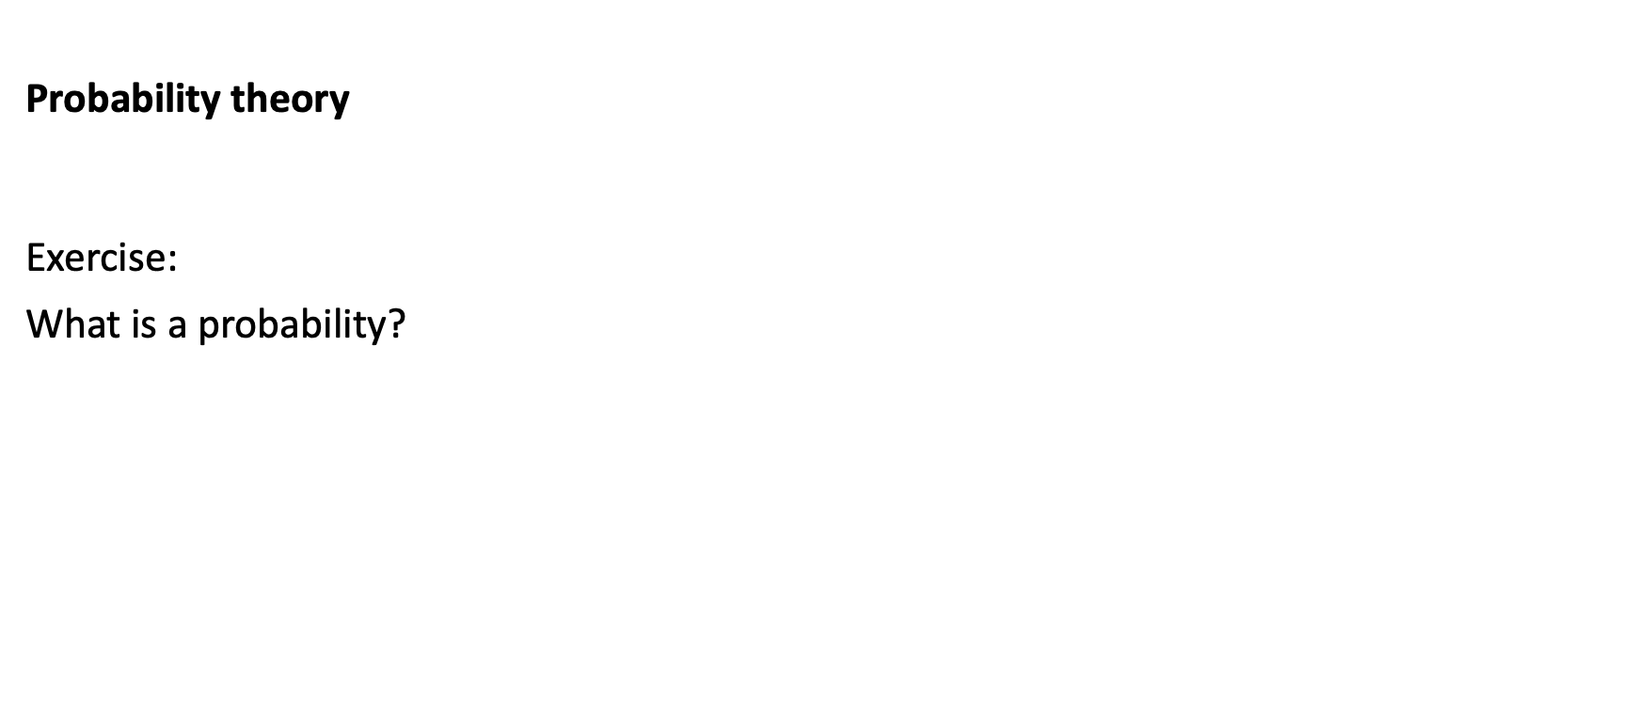
Probability theory
Exercise:
What is a probability?

Slide 14
Statistics & uncertainty
PROBABILITY
To quantify uncertainty we need to use the tools of probability theory.
STATISTICS
To gain insights from observational data we need to make statistical inference.

Slide 15
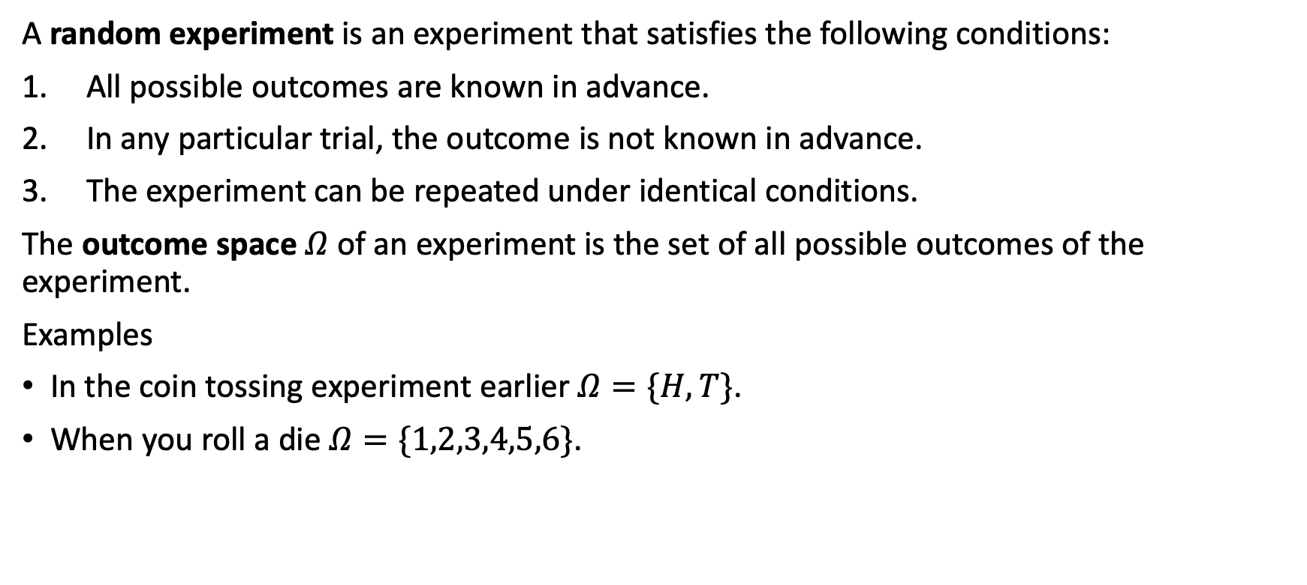
Probability theory: random experiments
A random experiment is an experiment that satisfies the following conditions:
All possible outcomes are known in advance.
In any particular trial, the outcome is not known in advance.
The experiment can be repeated under identical conditions.
The outcome space $Ω$ of an experiment is the set of all possible outcomes of the experiment.
Examples
In the coin tossing experiment earlier $Ω=\{H,T\}$.
When you roll a die $Ω=\{1,2,3,4,5,6\}$.

Slide 16
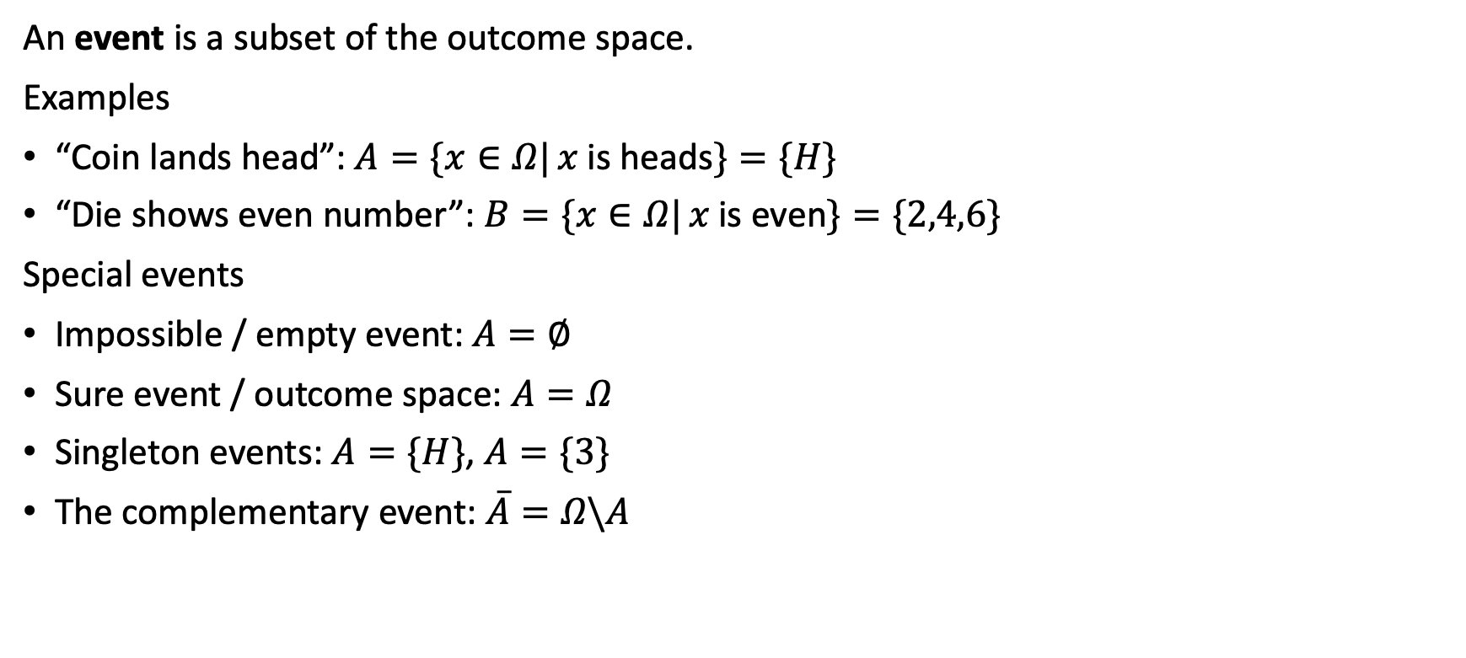
Probability theory: random experiments
An event is a subset of the outcome space.
Examples
“Coin lands head”: $A=\{x∈Ω| x \text{is} \text{heads}\}=\{H\}$
“Die shows even number”: $B=\{x∈Ω| x \text{is} \text{even}\}=\{2,4,6\}$
Special events
Impossible / empty event: $A=∅$
Sure event / outcome space: $A=Ω$
Singleton events: $A=\{H\}$, $A=\{3\}$
The complementary event: $\overset{‾}{A}=Ω\backslash A$

Slide 17
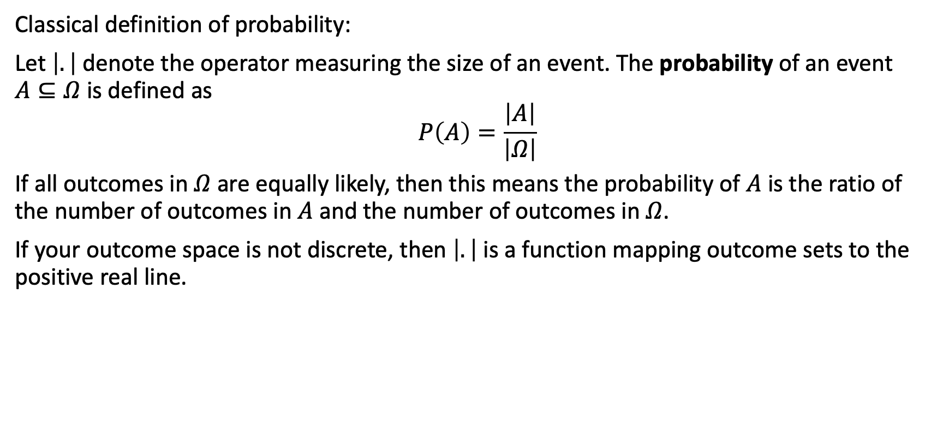
Probability theory: probability
Classical definition of probability:
Let $\left|.\right|$ denote the operator measuring the size of an event. The probability of an event $A⊆Ω$ is defined as
$$P\left(A\right)=\frac{\left|A\right|}{\left|Ω\right|}$$
If all outcomes in $Ω$ are equally likely, then this means the probability of $A$ is the ratio of the number of outcomes in $A$ and the number of outcomes in $Ω$.
If your outcome space is not discrete, then $\left|.\right|$ is a function mapping outcome sets to the positive real line.

Slide 18
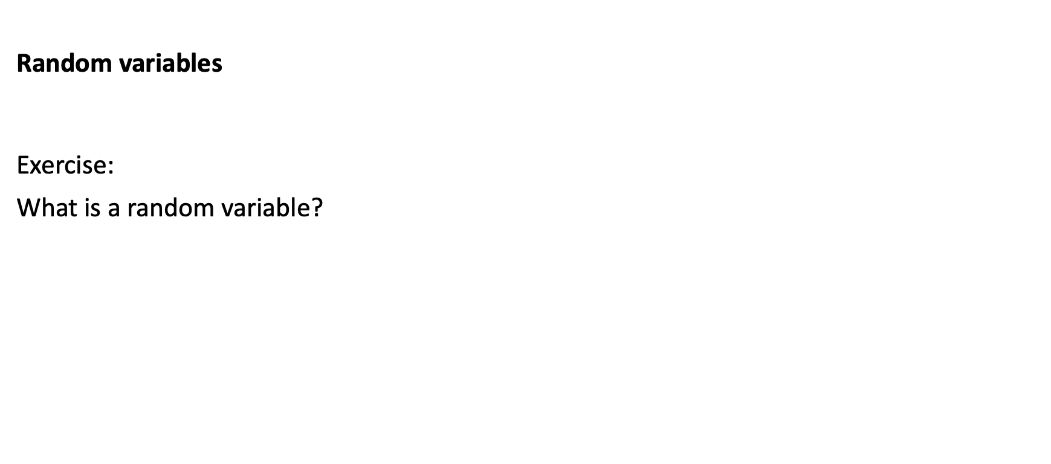
Random variables
Exercise:
What is a random variable?

Slide 19
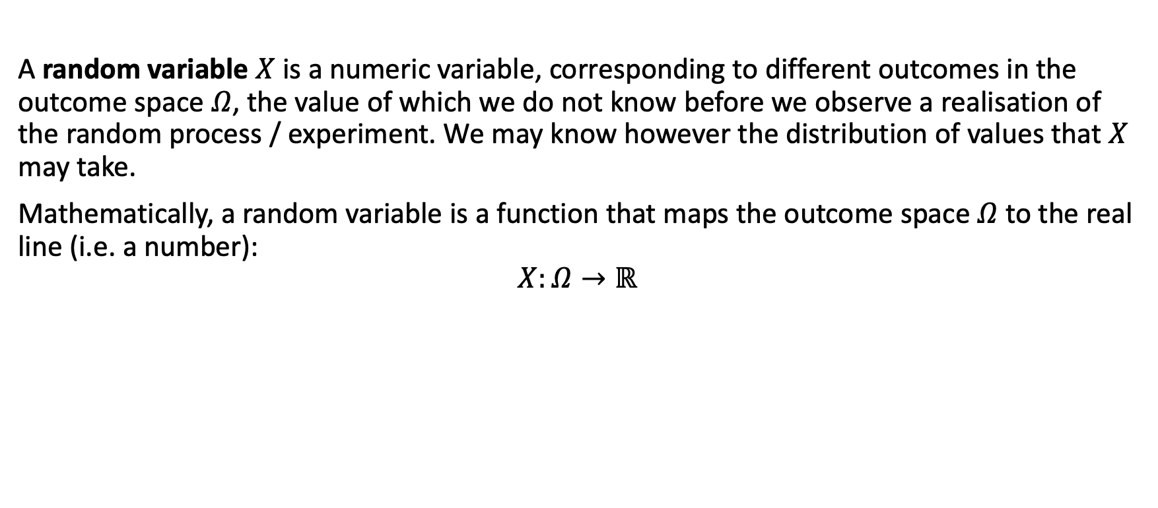
Random variables
A random variable $X$ is a numeric variable, corresponding to different outcomes in the outcome space $Ω$, the value of which we do not know before we observe a realisation of the random process / experiment. We may know however the distribution of values that $X$ may take.
Mathematically, a random variable is a function that maps the outcome space $Ω$ to the real line (i.e. a number):
$$X:Ω→ℝ$$

Slide 20
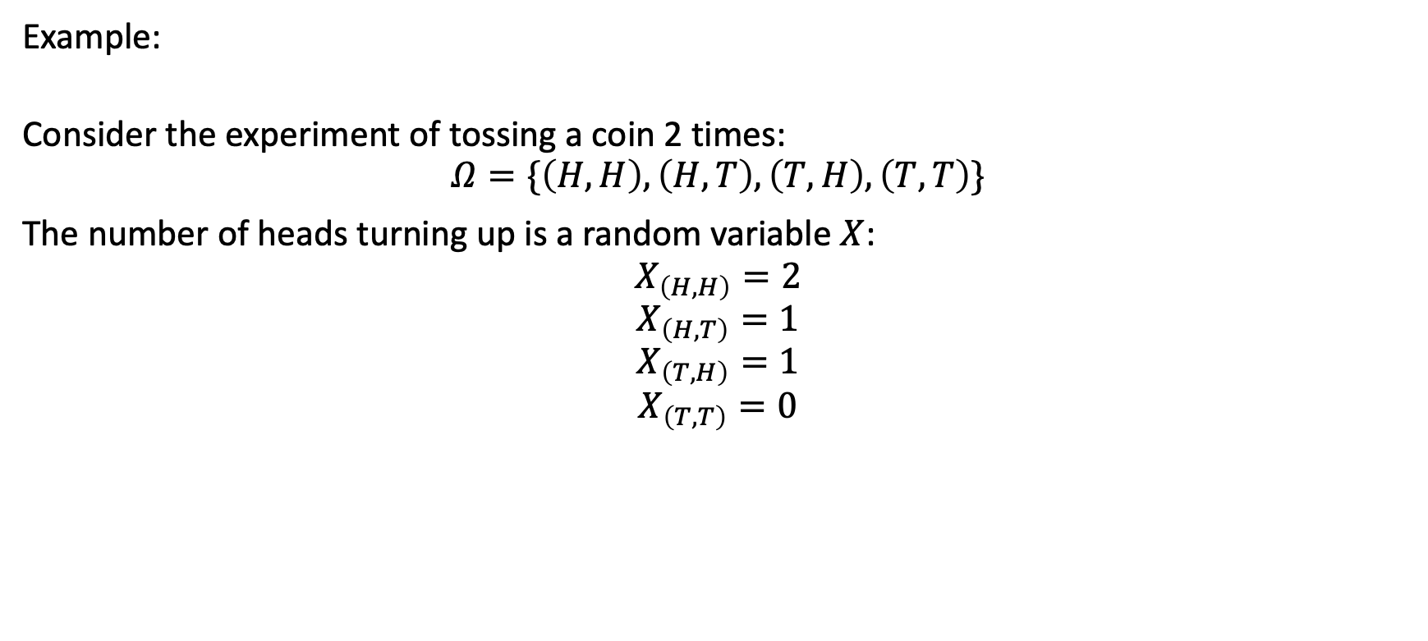
Random variables
Example:
Consider the experiment of tossing a coin 2 times:
$$Ω=\{\left(H,H\right),\left(H,T\right),\left(T,H\right),\left(T,T\right)\}$$
The number of heads turning up is a random variable $X$:
$$X_{\left(H,H\right)}=2$$
$$X_{\left(H,T\right)}=1$$
$$X_{\left(T,H\right)}=1$$
$$X_{\left(T,T\right)}=0$$

Slide 21
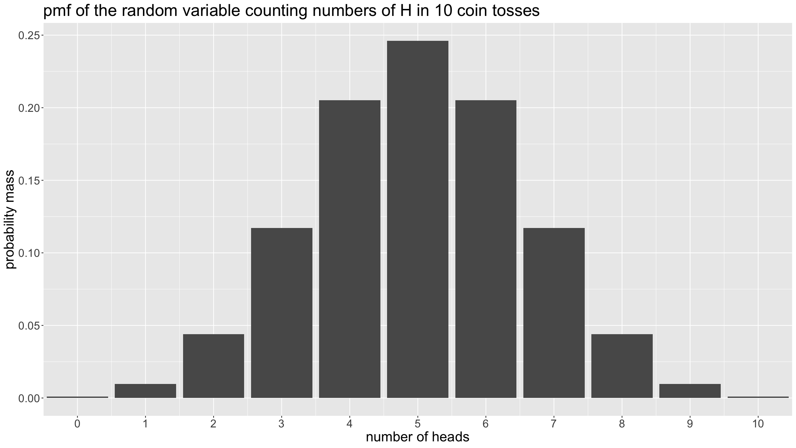
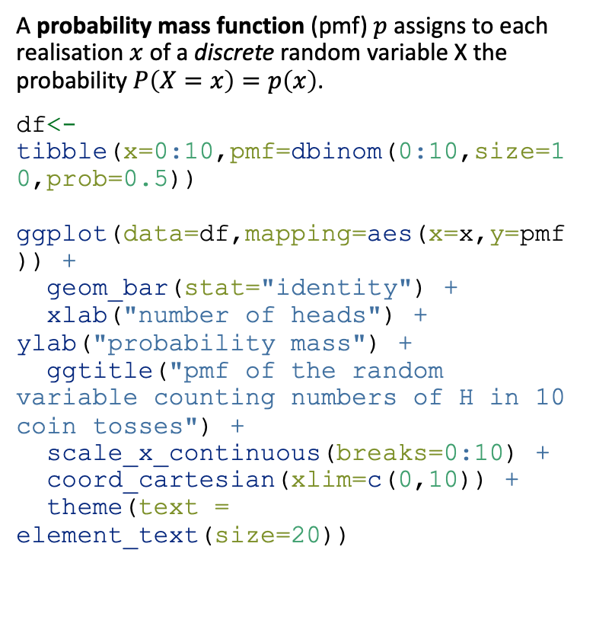
Random variables: probability distribution
A probability mass function (pmf) $p$ assigns to each realisation $x$ of a discrete random variable X the probability $P\left(X=x\right)=p\left(x\right)$.
df<-tibble(x=0:10,pmf=dbinom(0:10,size=10,prob=0.5)) ggplot(data=df,mapping=aes(x=x,y=pmf)) + geom_bar(stat="identity") + xlab("number of heads") + ylab("probability mass") + ggtitle("pmf of the random variable counting numbers of H in 10 coin tosses") + scale_x_continuous(breaks=0:10) + coord_cartesian(xlim=c(0,10)) + theme(text = element_text(size=20))

Slide 22
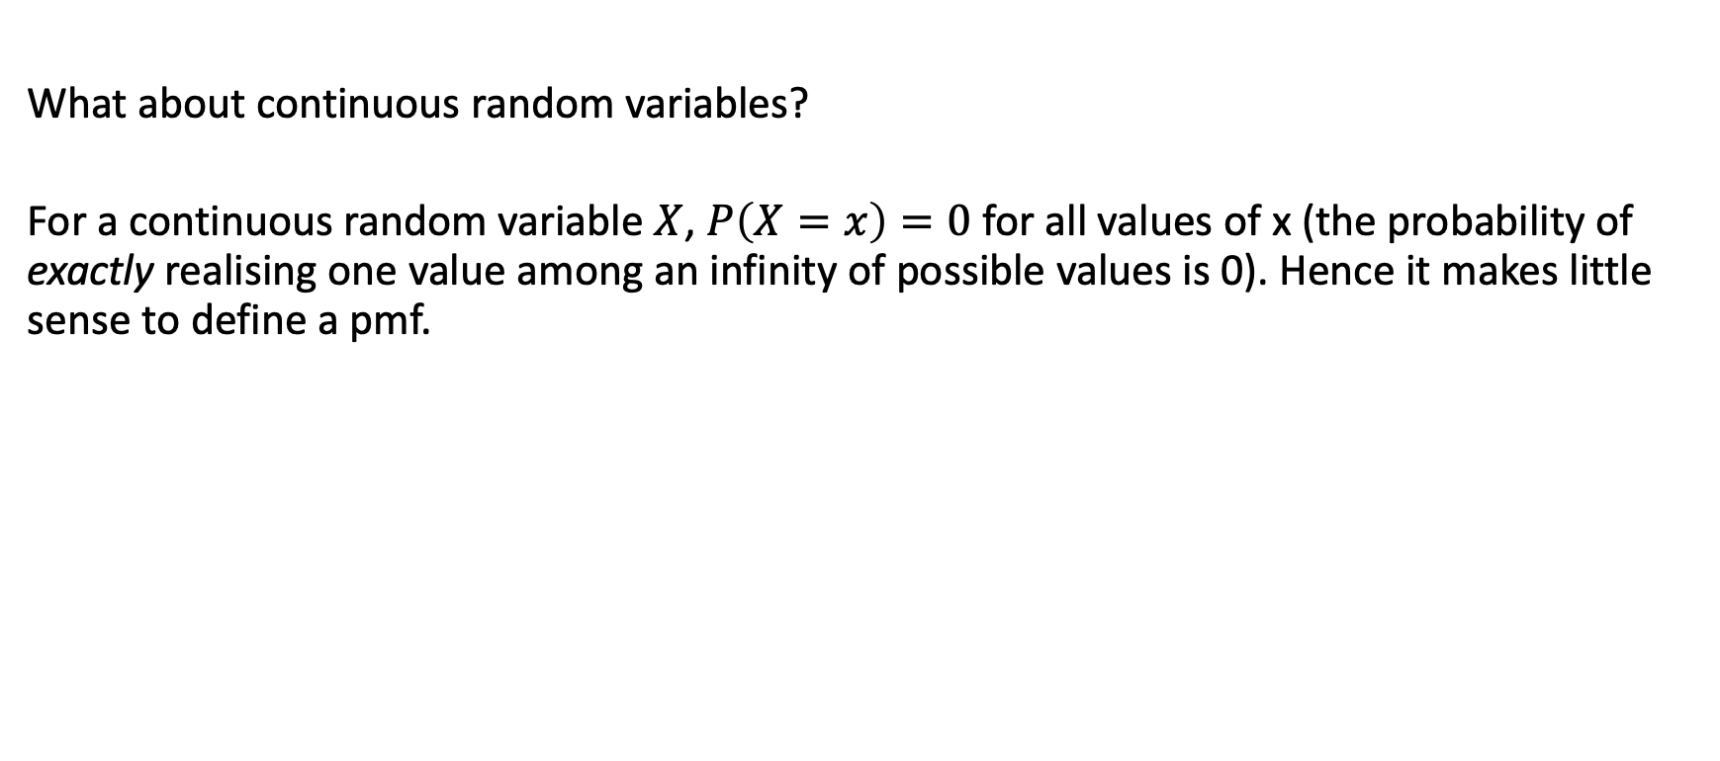
Random variables: probability distribution
What about continuous random variables?
For a continuous random variable $X$, $P\left(X=x\right)=0$ for all values of x (the probability of exactly realising one value among an infinity of possible values is 0). Hence it makes little sense to define a pmf.

Slide 23
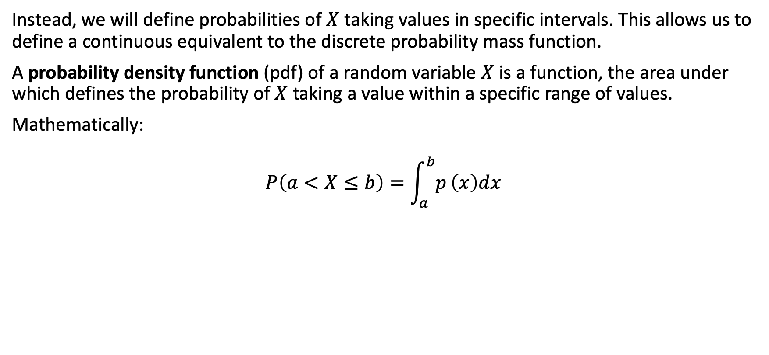
Random variables: probability distribution
Instead, we will define probabilities of $X$ taking values in specific intervals. This allows us to define a continuous equivalent to the discrete probability mass function.
A probability density function (pdf) of a random variable $X$ is a function, the area under which defines the probability of $X$ taking a value within a specific range of values.
Mathematically:
$$P\left(a<X≤b\right)=\int_{a}^{b}{p}\left(x\right)dx$$

Slide 24
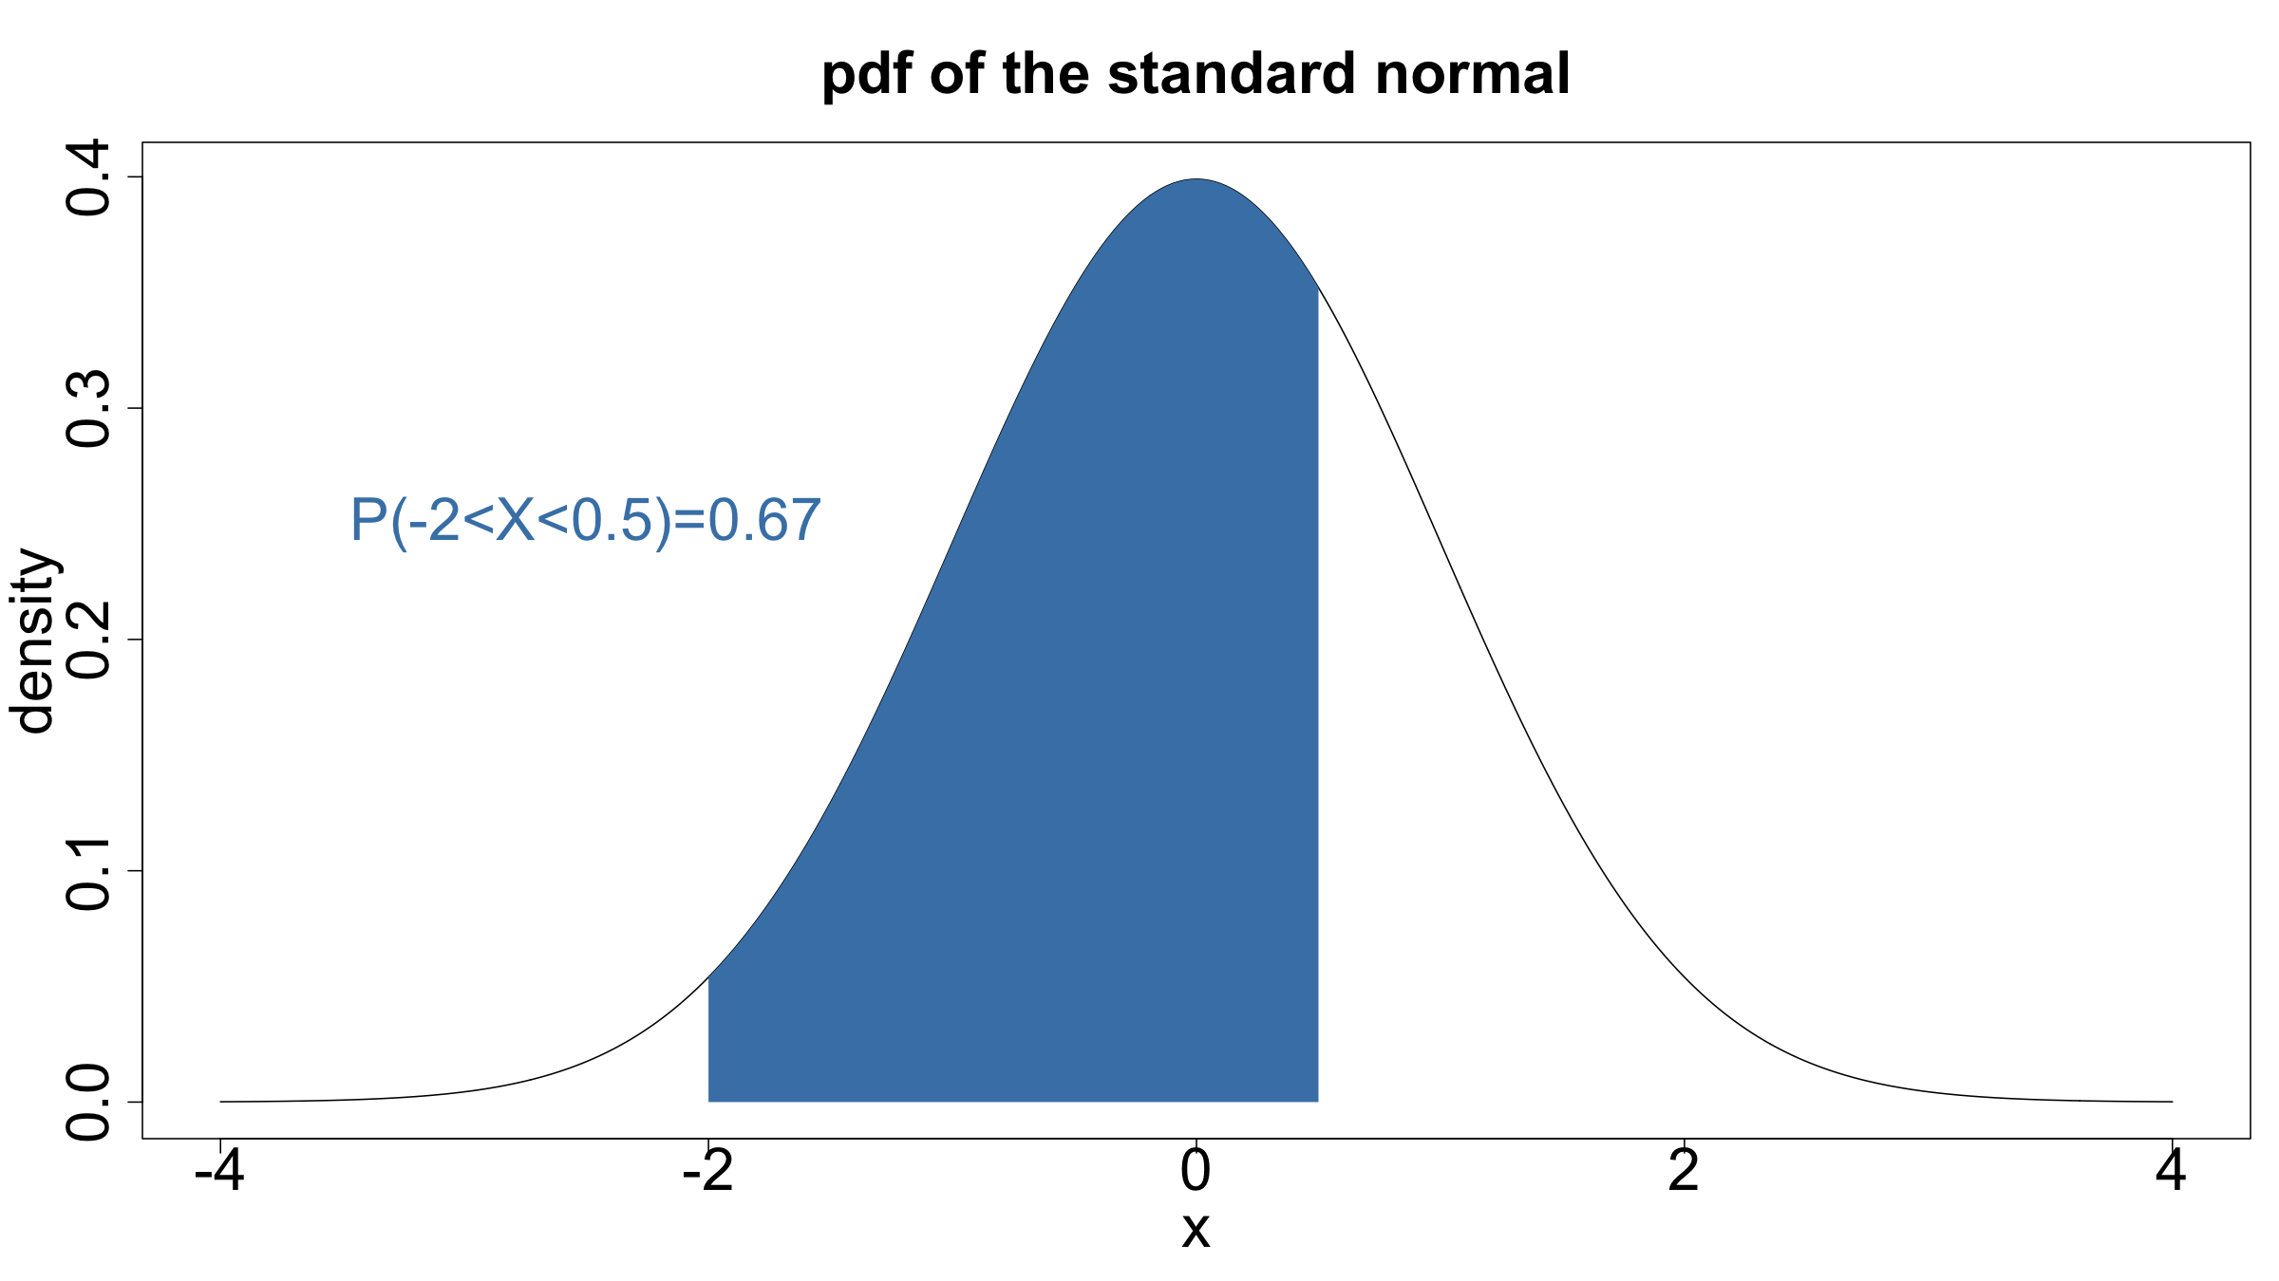
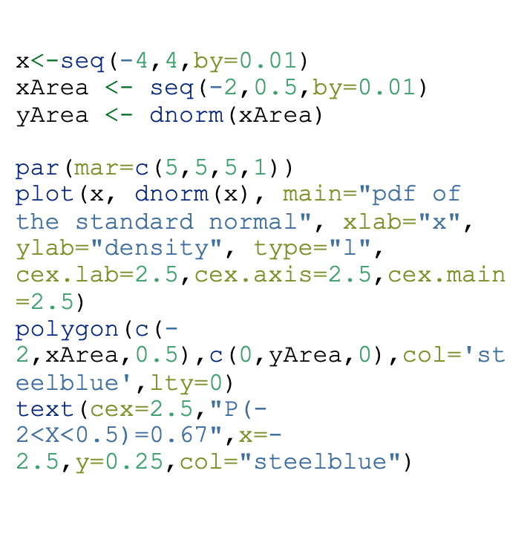
Random variables: probability distribution
x<-seq(-4,4,by=0.01) xArea <- seq(-2,0.5,by=0.01) yArea <- dnorm(xArea) par(mar=c(5,5,5,1)) plot(x, dnorm(x), main="pdf of the standard normal", xlab="x", ylab="density", type="l", cex.lab=2.5,cex.axis=2.5,cex.main=2.5) polygon(c(-2,xArea,0.5),c(0,yArea,0),col='steelblue',lty=0) text(cex=2.5,"P(-2<X<0.5)=0.67",x=-2.5,y=0.25,col="steelblue")

Slide 25
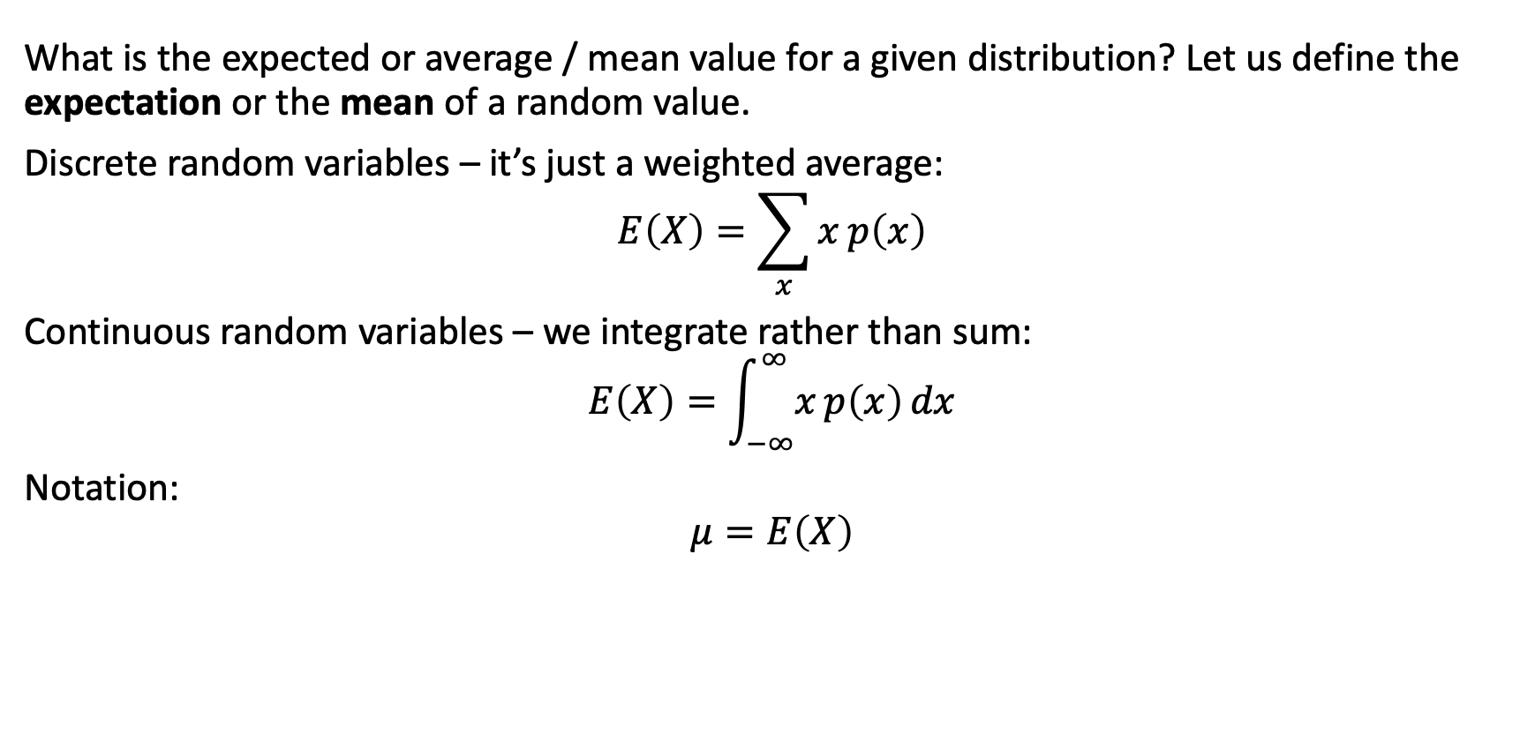
Random variables: expectation & variance
What is the expected or average / mean value for a given distribution? Let us define the expectation or the mean of a random value.
Discrete random variables – it’s just a weighted average:
$$E\left(X\right)=\sum_{x}^{​}{x p\left(x\right)}$$
Continuous random variables – we integrate rather than sum:
$$E\left(X\right)=\int_{−∞}^{∞}{x p\left(x\right) dx}$$
Notation:
$$μ=E\left(X\right)$$

Slide 26
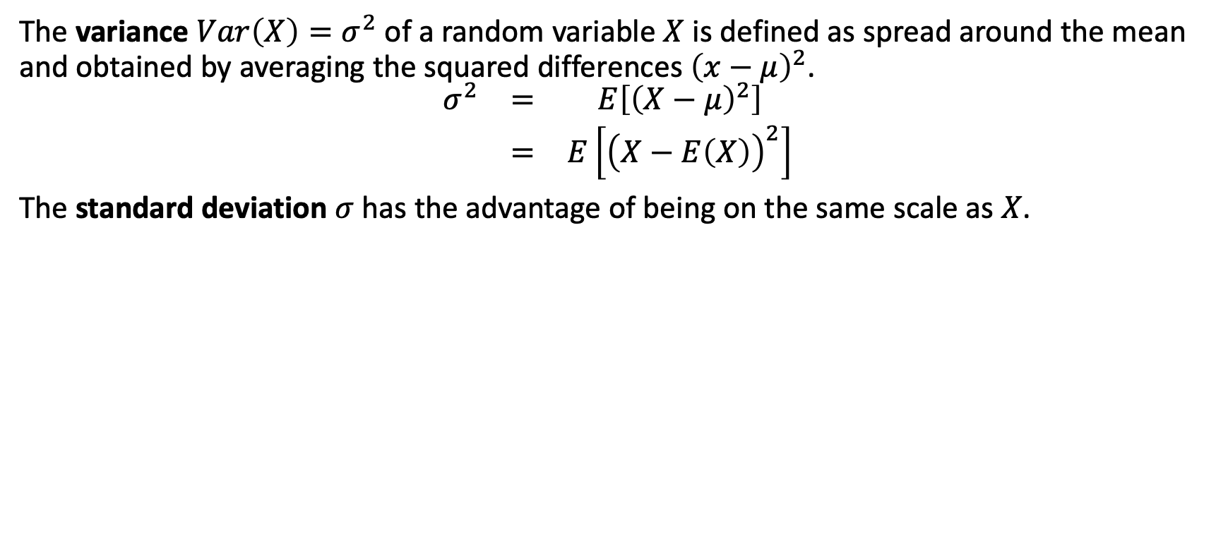
Random variables: expectation & variance
The variance $Var\left(X\right)=σ^{2}$ of a random variable $X$ is defined as spread around the mean and obtained by averaging the squared differences ${\left(x−μ\right)}^{2}$.
$$\begin{matrix}σ^{2} & = & E\left[{\left(X−μ\right)}^{2}\right] \\ & = & E\left[{\left(X−E\left(X\right)\right)}^{2}\right]\end{matrix}$$
The standard deviation $σ$ has the advantage of being on the same scale as $X$.

Slide 27

Common distributions

Slide 28
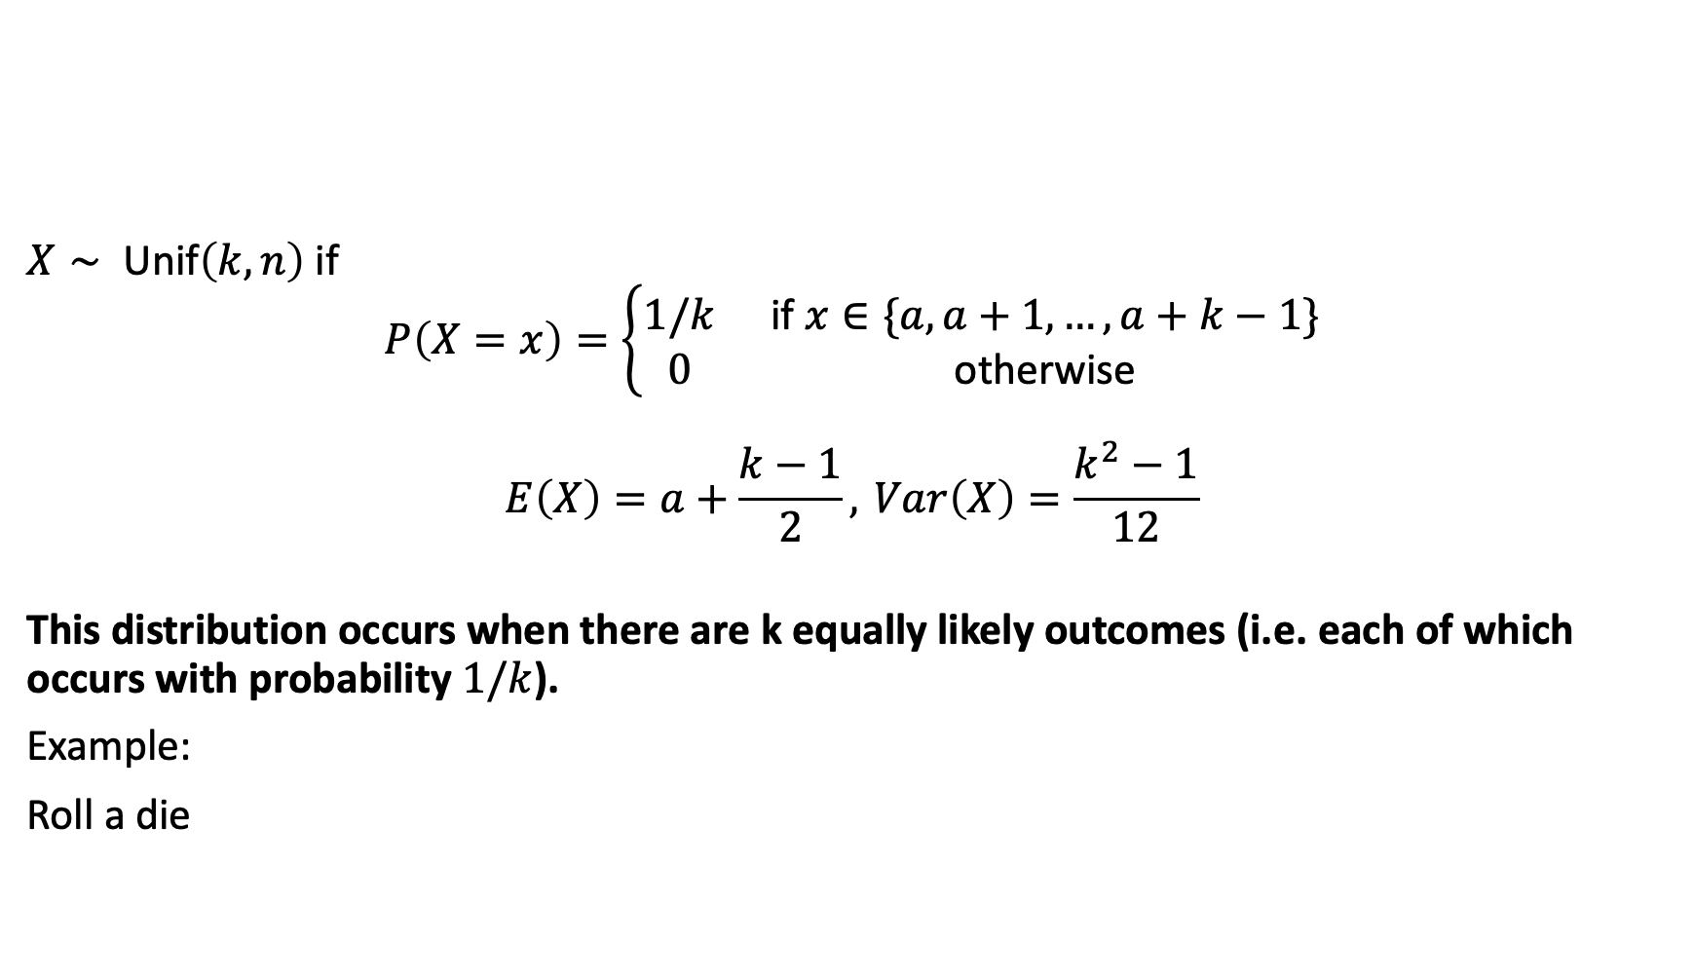
Common distributions: discrete uniform
$X∼ \text{Unif}\left(k,n\right)$ if
$$P\left(X=x\right)=\left\{\begin{matrix}1/k & \text{if} x∈\{a,a+1,…,a+k−1\} \\ 0 & \text{otherwise}\end{matrix}\right.$$
$$E\left(X\right)=a+\frac{k−1}{2}, Var\left(X\right)=\frac{k^{2}−1}{12}$$
This distribution occurs when there are k equally likely outcomes (i.e. each of which occurs with probability $1/k$).
Example:
Roll a die

Slide 29
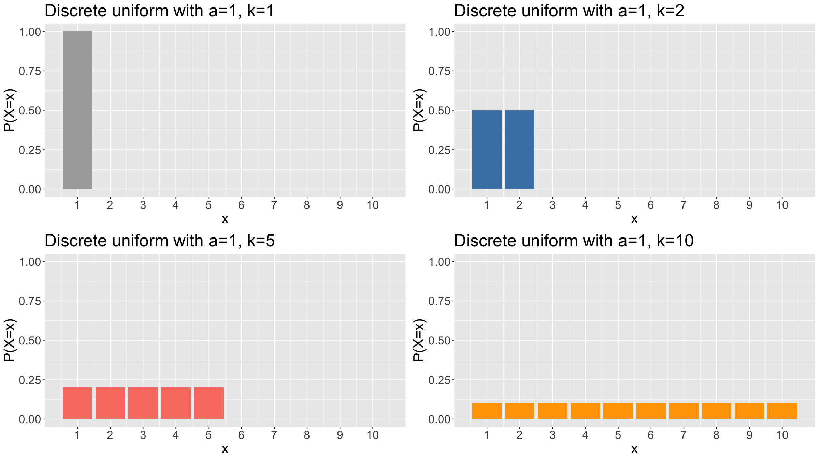
Common distributions: discrete uniform
plotDUnif<-function(k,col,maxK=10){ x<-seq(1,k,by=1) px<-rep(1/k,k) df<-tibble(x=x,px=px) g<-ggplot(data=df,mapping=aes(x=x,y=px)) + geom_bar(stat="identity",fill=col) + ylab("P(X=x)") + theme(text = element_text(size=20)) + ggtitle(paste(sep="","Discrete uniform with a=1, k=",k)) + scale_x_continuous(breaks=1:maxK) + coord_cartesian(xlim=c(0.5,maxK+0.5),ylim=c(0,1)) return(g) } g1<-plotDUnif(1,"darkgrey"); g2<-plotDUnif(2,"steelblue") g3<-plotDUnif(5,"salmon"); g4<-plotDUnif(10,"orange") grid.arrange(g1,g2,g3,g4)

Slide 30
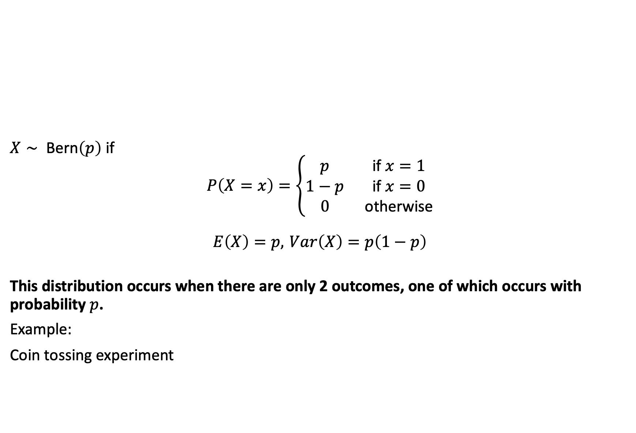
Common distributions: Bernoulli
$X∼ \text{Bern}\left(p\right)$ if
$$P\left(X=x\right)=\left\{\begin{matrix}p & \text{if} x=1 \\ 1−p & \text{if} x=0 \\ 0 & \text{otherwise}\end{matrix}\right.$$
$$E\left(X\right)=p, Var\left(X\right)=p\left(1−p\right)$$
This distribution occurs when there are only 2 outcomes, one of which occurs with probability $p$.
Example:
Coin tossing experiment

Slide 31
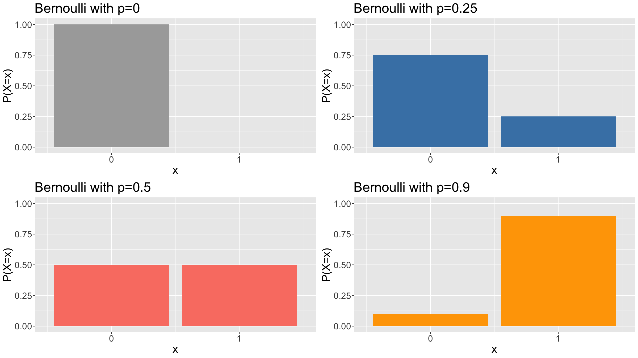
Common distributions: Bernoulli
plotBern<-function(p,col){ x<-seq(0,1,by=1) px<-dbinom(x,size=1,prob=p) df<-tibble(x=x,px=px) g<-ggplot(data=df,mapping=aes(x=x,y=px)) + geom_bar(stat="identity",fill=col) + ylab("P(X=x)") + theme(text = element_text(size=20)) + ggtitle(paste(sep="","Bernoulli with p=",p)) + scale_x_continuous(breaks=0:1) + coord_cartesian(xlim=c(-0.5,1.5),ylim=c(0,1)) return(g) } g1<-plotBern(0,"darkgrey"); g2<-plotBern(0.25,"steelblue") g3<-plotBern(0.5,"salmon"); g4<-plotBern(0.9,"orange") grid.arrange(g1,g2,g3,g4)

Slide 32
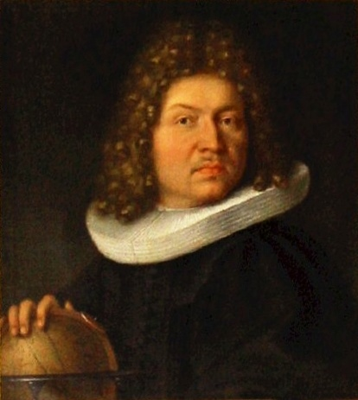
Common distributions: Bernoulli
Jacob Bernoulli (public domain / Wikipedia)

Slide 33
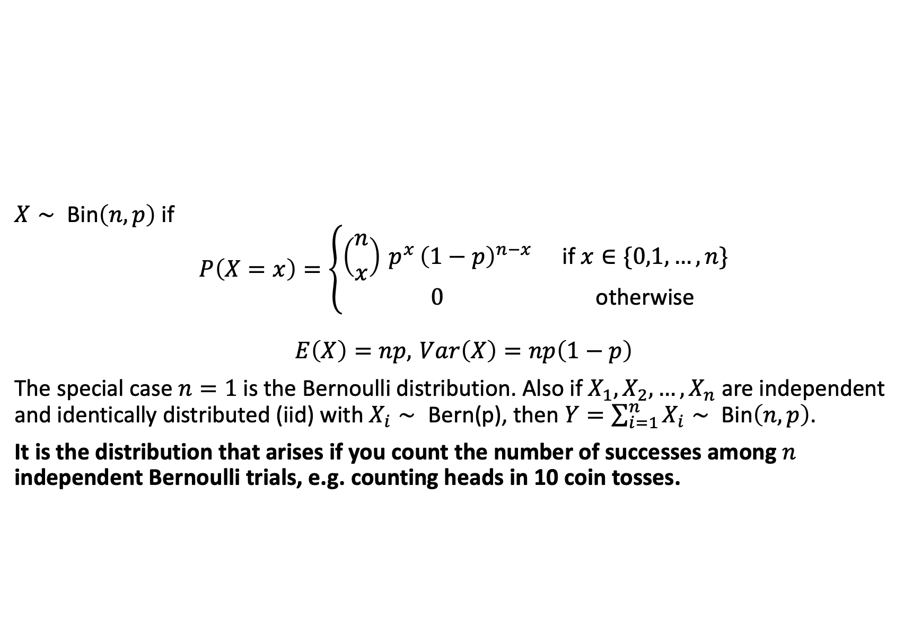
Common distributions: Binomial
$X∼ \text{Bin}\left(n,p\right)$ if
$$P\left(X=x\right)=\left\{\begin{matrix}\left({n \atop x}\right) p^{x} {\left(1−p\right)}^{n−x} & \text{if} x∈\{0,1,…,n\} \\ 0 & \text{otherwise}\end{matrix}\right.$$
$$E\left(X\right)=np, Var\left(X\right)=np\left(1−p\right)$$
The special case $n=1$ is the Bernoulli distribution. Also if $X_{1},X_{2},…,X_{n}$ are independent and identically distributed (iid) with $X_{i}∼ \text{Bern}\text{(}\text{p}\text{)}$, then $Y=\sum_{i=1}^{n}{X_{i}}∼ \text{Bin}\left(n,p\right)$.
It is the distribution that arises if you count the number of successes among $n$ independent Bernoulli trials, e.g. counting heads in 10 coin tosses.

Slide 34
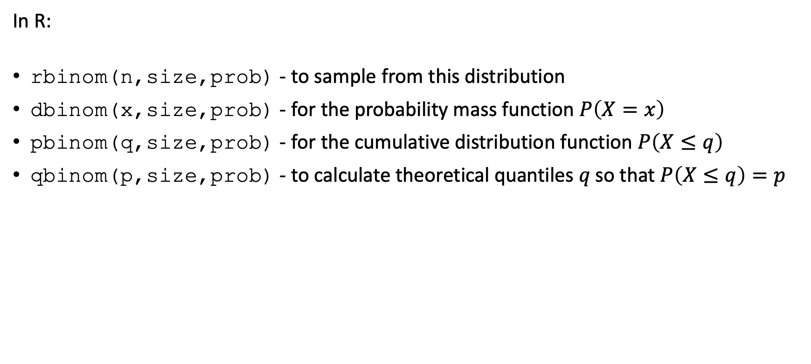
Common distributions: Binomial
In R:
rbinom(n,size,prob) - to sample from this distribution
dbinom(x,size,prob) - for the probability mass function $P\left(X=x\right)$
pbinom(q,size,prob) - for the cumulative distribution function $P\left(X≤q\right)$
qbinom(p,size,prob) - to calculate theoretical quantiles $q \text{so} \text{that} P\left(X≤q\right)=p$

Slide 35
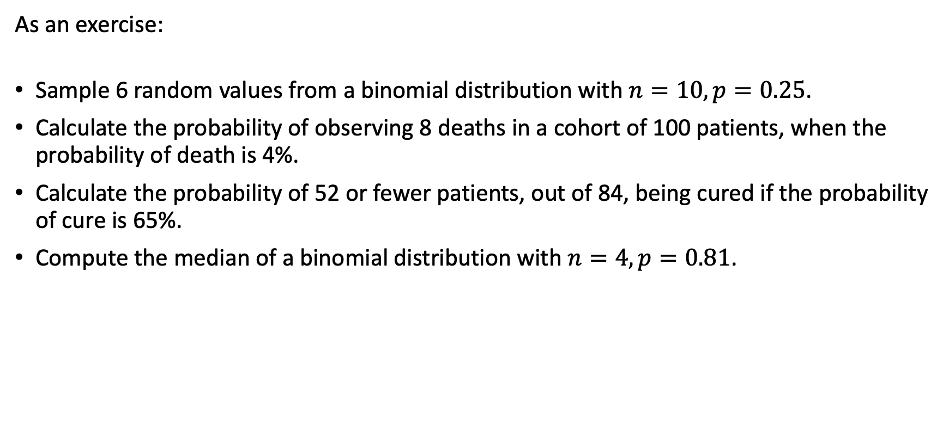
Common distributions: Binomial
As an exercise:
Sample 6 random values from a binomial distribution with $n=10,p=0.25$.
Calculate the probability of observing 8 deaths in a cohort of 100 patients, when the probability of death is 4%.
Calculate the probability of 52 or fewer patients, out of 84, being cured if the probability of cure is 65%.
Compute the median of a binomial distribution with $n=4,p=0.81$.

Slide 36
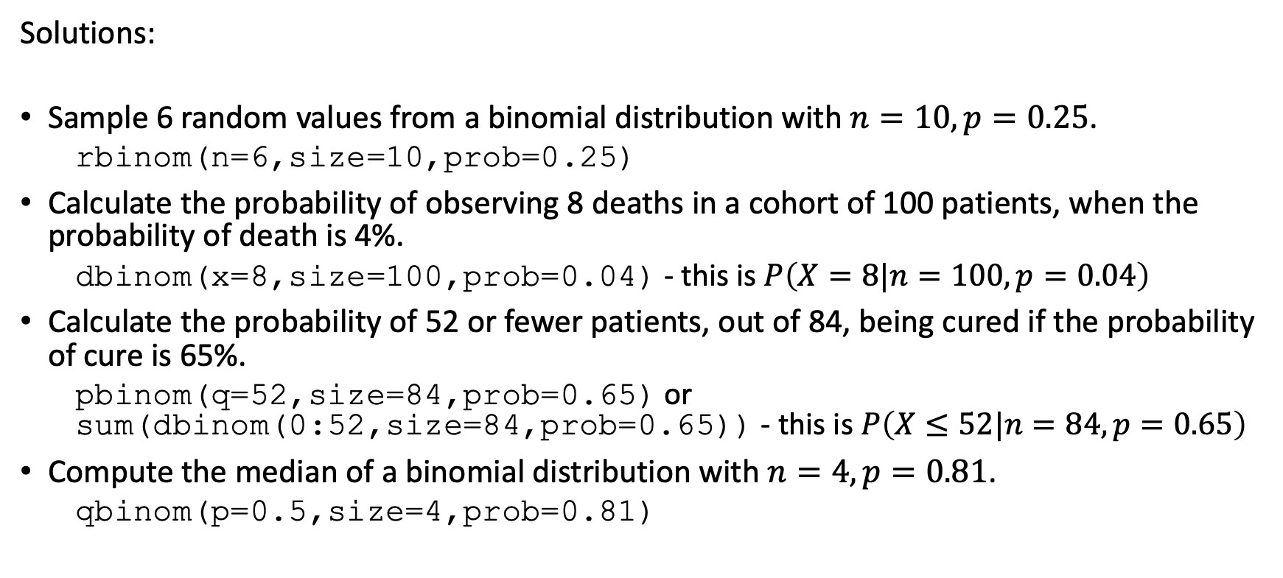
Common distributions: Binomial
Solutions:
Sample 6 random values from a binomial distribution with $n=10,p=0.25$.
rbinom(n=6,size=10,prob=0.25)
Calculate the probability of observing 8 deaths in a cohort of 100 patients, when the probability of death is 4%.
dbinom(x=8,size=100,prob=0.04) - this is $P\left(X=8|n=100,p=0.04\right)$
Calculate the probability of 52 or fewer patients, out of 84, being cured if the probability of cure is 65%.
pbinom(q=52,size=84,prob=0.65) or sum(dbinom(0:52,size=84,prob=0.65)) - this is $P\left(X≤52|n=84,p=0.65\right)$
Compute the median of a binomial distribution with $n=4,p=0.81$.
qbinom(p=0.5,size=4,prob=0.81)

Slide 37
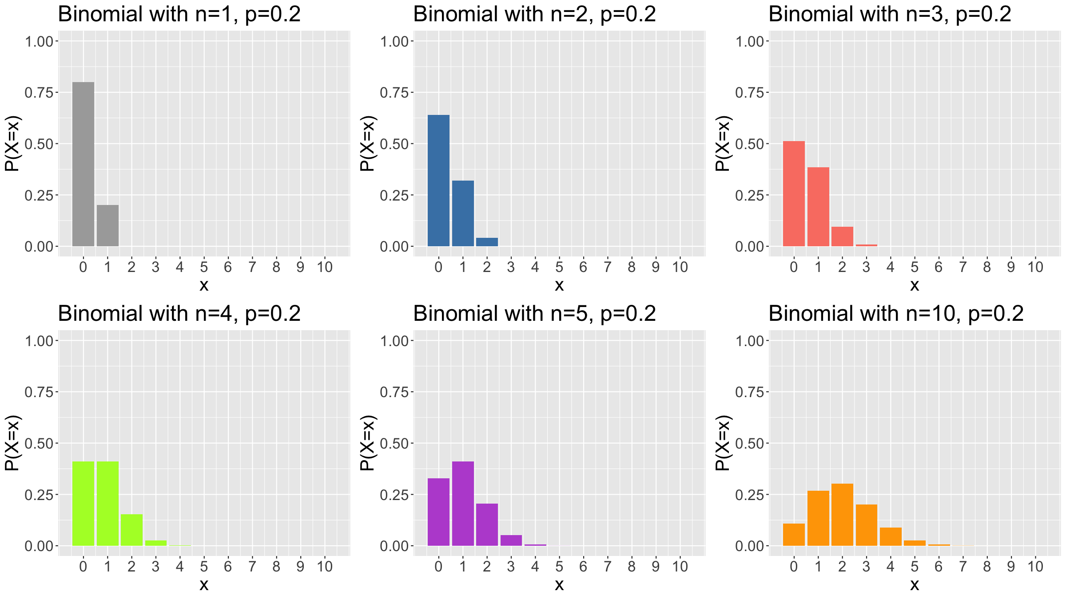
Common distributions: Binomial
plotBin<-function(n,p,col,maxN=10){ x<-seq(0,n,by=1) px<-dbinom(x,size=n,prob=p) df<-tibble(x=x,px=px) g<-ggplot(data=df,mapping=aes(x=x,y=px)) + geom_bar(stat="identity",fill=col) + ylab("P(X=x)") + theme(text = element_text(size=20)) + ggtitle(paste(sep="","Binomial with n=",n,", p=",p)) + scale_x_continuous(breaks=0:maxN) + coord_cartesian(xlim=c(-0.5,maxN+0.5),ylim=c(0,1)) return(g) } g1<-plotBin(1,.2,"darkgrey"); g2<-plotBin(2,.2,"steelblue") g3<-plotBin(3,.2,"salmon"); g4<-plotBin(4,.2,"greenyellow") g5<-plotBin(5,.2,"mediumorchid"); g6<-plotBin(10,.2,"orange") grid.arrange(g1,g2,g3,g4,g5,g6,ncol=3)

Slide 38
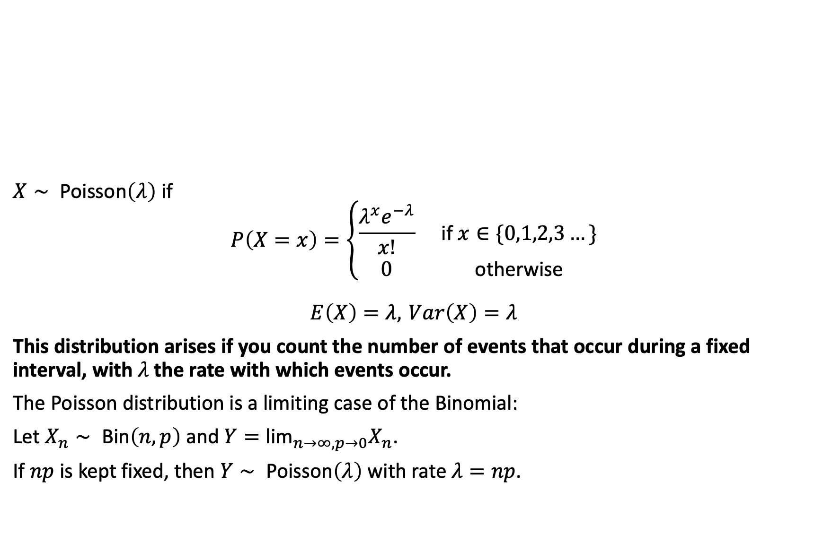
Common distributions: Poisson
$X∼ \text{Poisson}\left(λ\right)$ if
$$P\left(X=x\right)=\left\{\begin{matrix}\frac{λ^{x}e^{−λ}}{x!} & \text{if} x∈\{0,1,2,3…\} \\ 0 & \text{otherwise}\end{matrix}\right.$$
$$E\left(X\right)=λ, Var\left(X\right)=λ$$
This distribution arises if you count the number of events that occur during a fixed interval, with $λ$ the rate with which events occur.
The Poisson distribution is a limiting case of the Binomial:
Let $X_{n}∼ \text{Bin}\left(n,p\right)$ and $Y={\text{lim}}_{n→∞,p→0}X_{n}$.
If $np$ is kept fixed, then $Y∼ \text{Poisson}\left(λ\right)$ with rate $λ=np$.

Slide 39
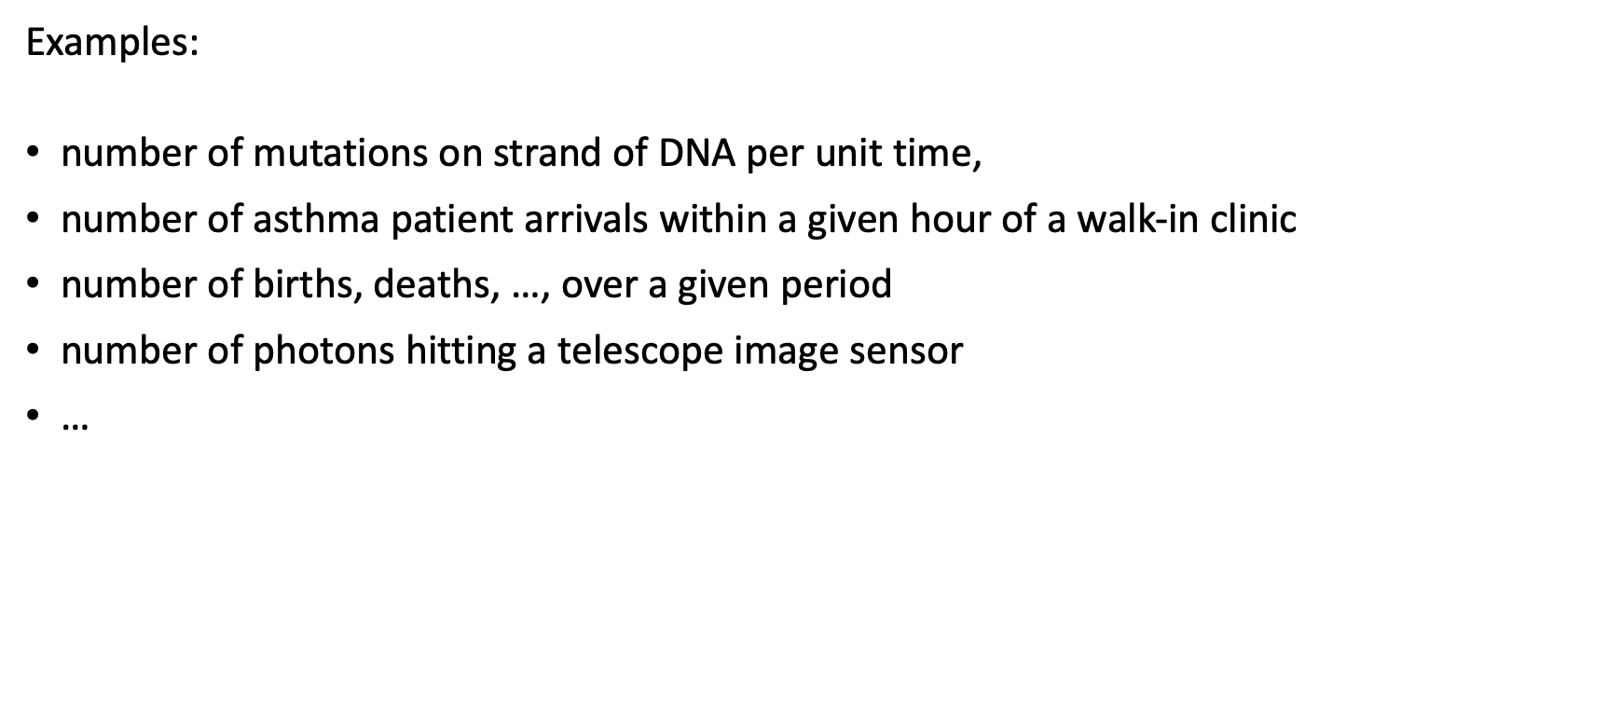
Common distributions: Poisson
Examples:
number of mutations on strand of DNA per unit time,
number of asthma patient arrivals within a given hour of a walk-in clinic
number of births, deaths, …, over a given period
number of photons hitting a telescope image sensor
…

Slide 40
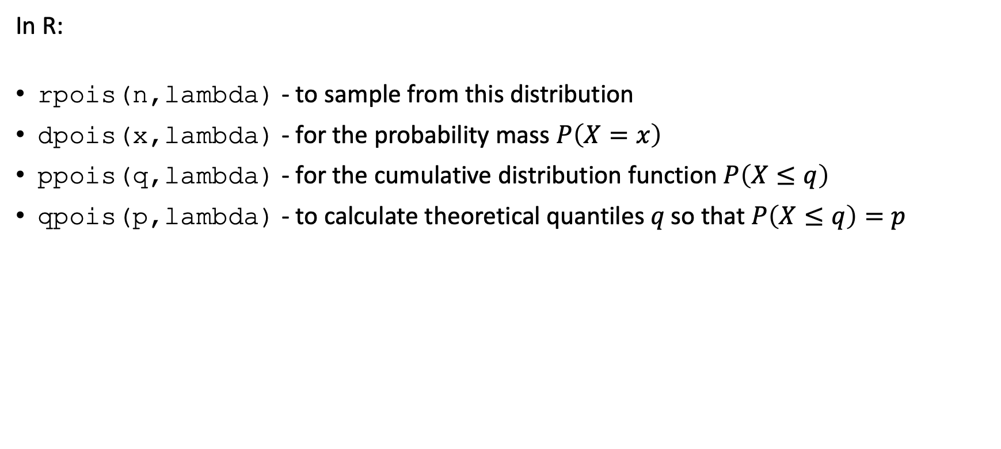
Common distributions: Poisson
In R:
rpois(n,lambda) - to sample from this distribution
dpois(x,lambda) - for the probability mass $P\left(X=x\right)$
ppois(q,lambda) - for the cumulative distribution function $P\left(X≤q\right)$
qpois(p,lambda) - to calculate theoretical quantiles $q \text{so} \text{that} P\left(X≤q\right)=p$

Slide 41
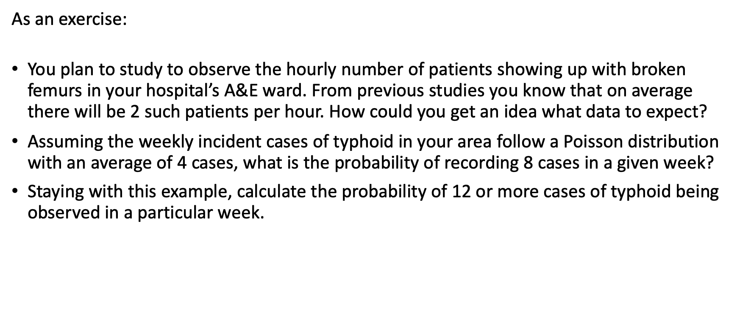
Common distributions: Poisson
As an exercise:
You plan to study to observe the hourly number of patients showing up with broken femurs in your hospital’s A&E ward. From previous studies you know that on average there will be 2 such patients per hour. How could you get an idea what data to expect?
Assuming the weekly incident cases of typhoid in your area follow a Poisson distribution with an average of 4 cases, what is the probability of recording 8 cases in a given week?
Staying with this example, calculate the probability of 12 or more cases of typhoid being observed in a particular week.

Slide 42
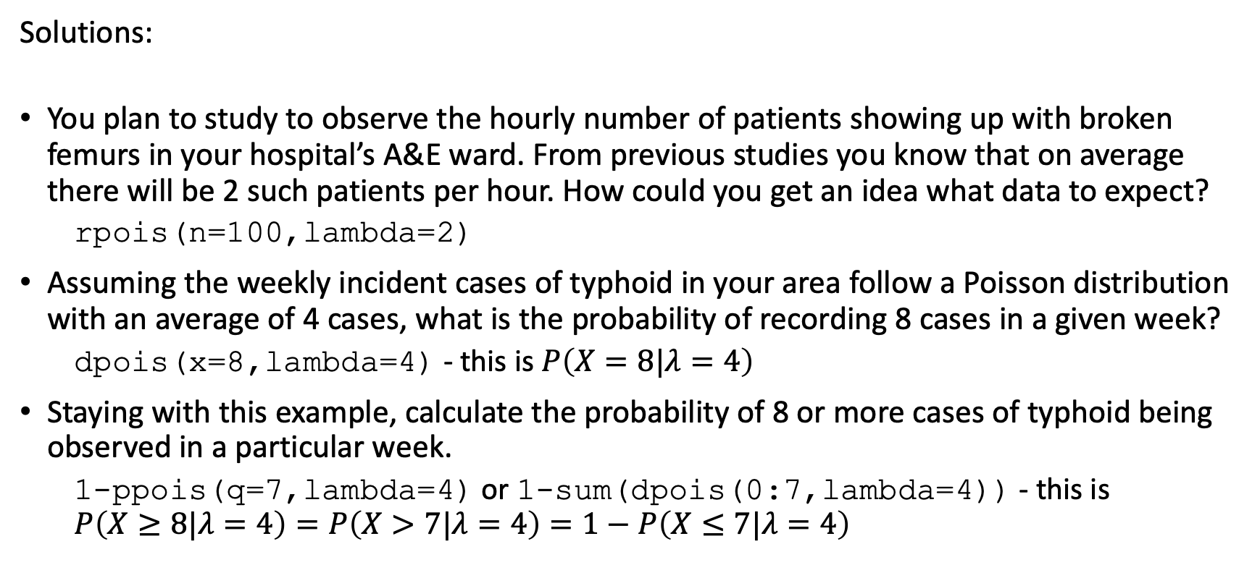
Common distributions: Poisson
Solutions:
You plan to study to observe the hourly number of patients showing up with broken femurs in your hospital’s A&E ward. From previous studies you know that on average there will be 2 such patients per hour. How could you get an idea what data to expect?
rpois(n=100,lambda=2)
Assuming the weekly incident cases of typhoid in your area follow a Poisson distribution with an average of 4 cases, what is the probability of recording 8 cases in a given week?
dpois(x=8,lambda=4) - this is $P\left(X=8|λ=4\right)$
Staying with this example, calculate the probability of 8 or more cases of typhoid being observed in a particular week.
1-ppois(q=7,lambda=4) or 1-sum(dpois(0:7,lambda=4)) - this is $P\left(X≥8|λ=4\right)=P\left(X>7|λ=4\right)=1−P\left(X≤7|λ=4\right)$

Slide 43
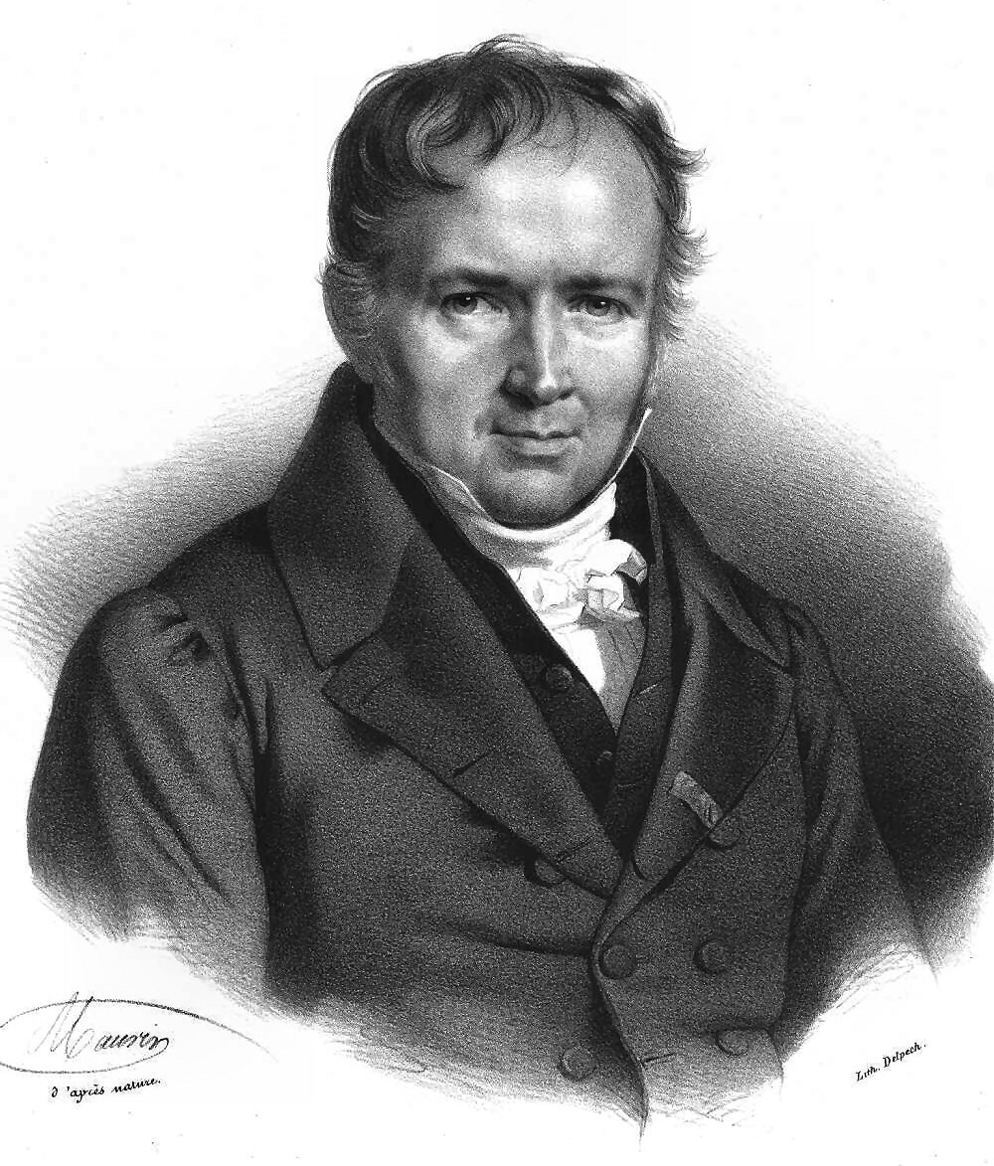
Common distributions: Poisson
Simeon Denis Poisson (public domain / Wikipedia)

Slide 44
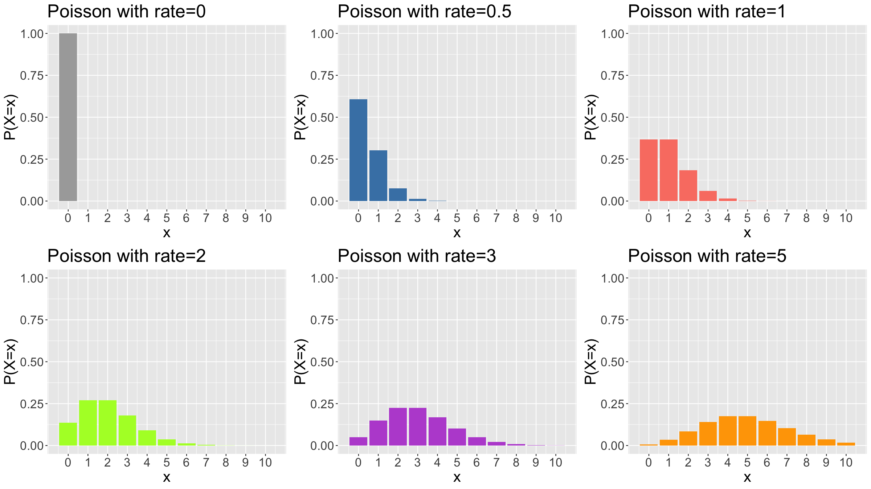
Common distributions: Poisson
plotPois<-function(lambda,col,maxK=10){ x<-seq(0,maxK,by=1) px<-dpois(x,lambda=lambda) df<-tibble(x=x,px=px) g<-ggplot(data=df,mapping=aes(x=x,y=px)) + geom_bar(stat="identity",fill=col) + ylab("P(X=x)") + theme(text = element_text(size=20)) + ggtitle(paste(sep="","Poisson with rate=",lambda)) + scale_x_continuous(breaks=0:maxK) + coord_cartesian(xlim=c(-0.5,maxK+0.5),ylim=c(0,1)) return(g) } g1<-plotPois(0,"darkgrey"); g2<-plotPois(0.5,"steelblue") g3<-plotPois(1,"salmon"); g4<-plotPois(2,"greenyellow") g5<-plotPois(3,"mediumorchid"); g6<-plotPois(5,"orange") grid.arrange(g1,g2,g3,g4,g5,g6,ncol=3)

Slide 45
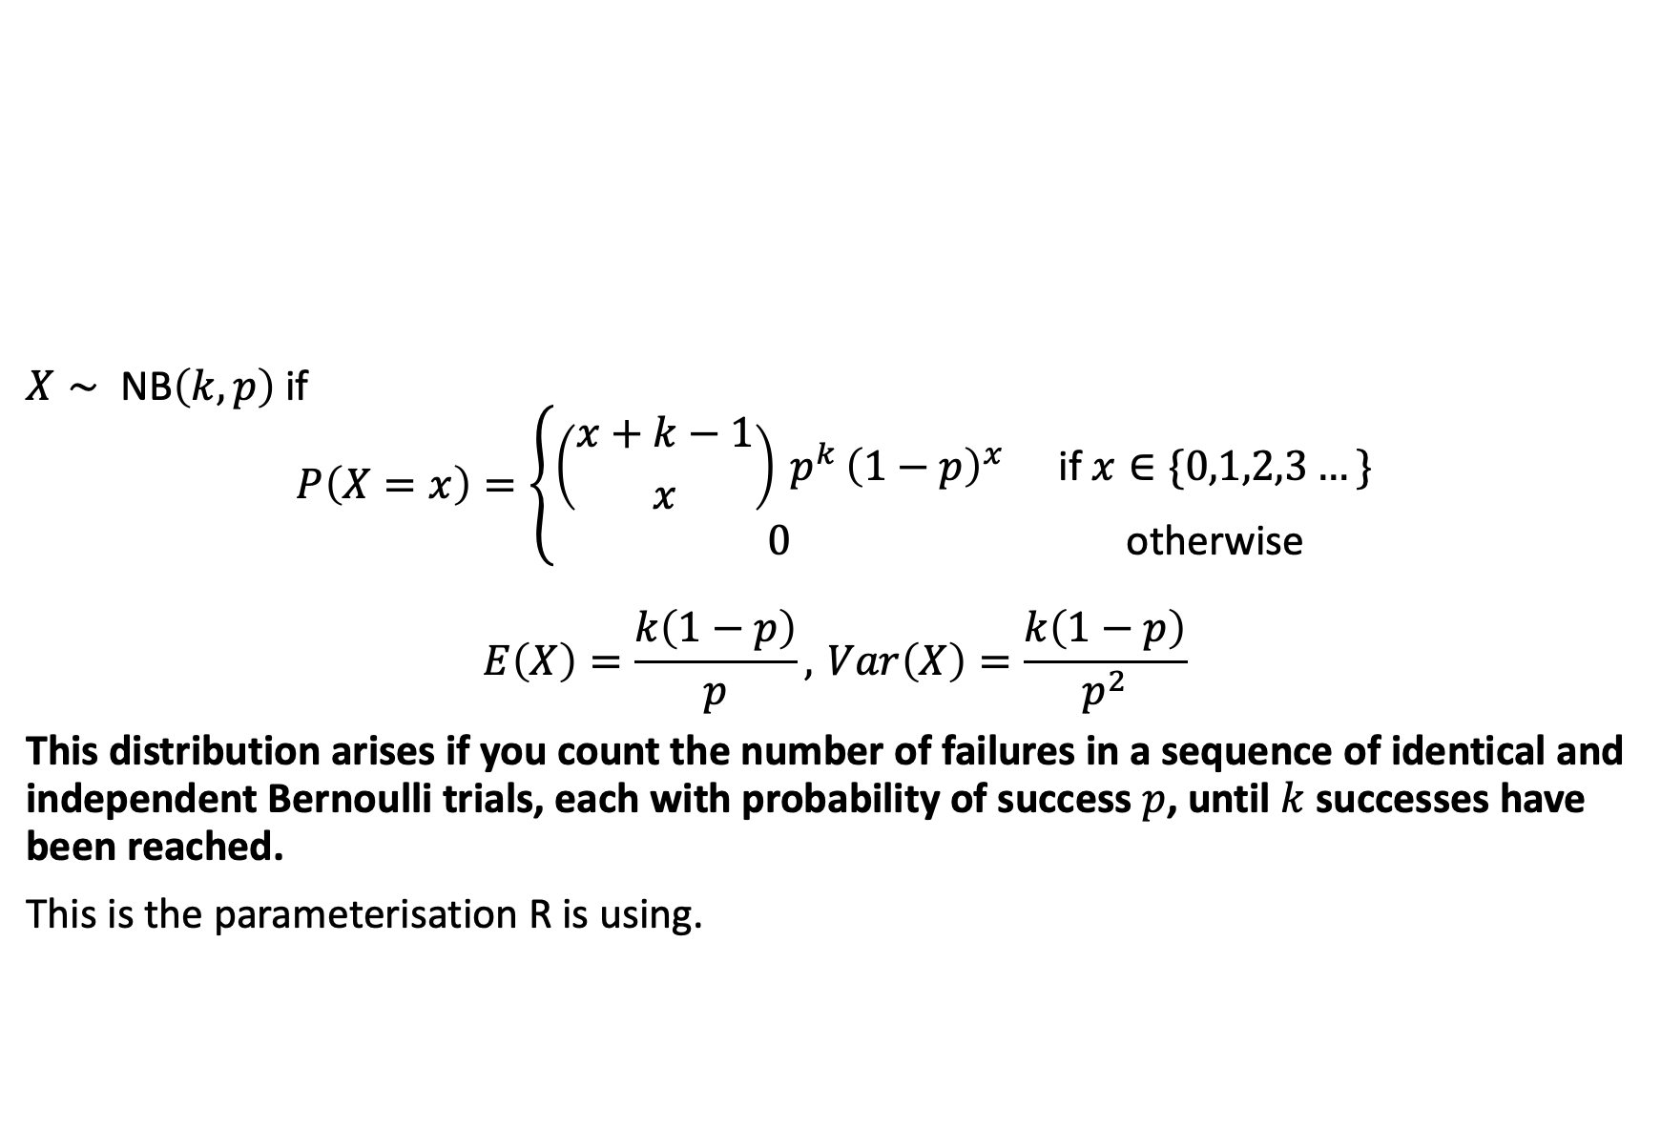
Common distributions: Negative binomial
$X∼ \text{NB}\left(k,p\right)$ if
$$P\left(X=x\right)=\left\{\begin{matrix}\left({x+k−1 \atop x}\right) p^{k} {\left(1−p\right)}^{x} & \text{if} x∈\{0,1,2,3…\} \\ 0 & \text{otherwise}\end{matrix}\right.$$
$$E\left(X\right)=\frac{k\left(1−p\right)}{p}, Var\left(X\right)=\frac{k\left(1−p\right)}{p^{2}}$$
This distribution arises if you count the number of failures in a sequence of identical and independent Bernoulli trials, each with probability of success $p$, until $k$ successes have been reached.
This is the parameterisation R is using.

Slide 46
Common distributions: Negative binomial
There are many alternative formulations / parameterisations for the Negative Binomial, so always check you know what the parameters mean (e.g. count the number of successes until a fixed number of failures have been reached).
Like the Poisson distribution, the negative binomial distribution is used in count data models. Unlike the Poisson it has 2 parameters, so is particularly useful when your counts show signs of overdispersion (i.e. larger variance than mean).
The negative binomial can be derived as a Gamma-Poisson mixture: Poisson distribution with variable rate parameter having a Gamma distribution.

Slide 47
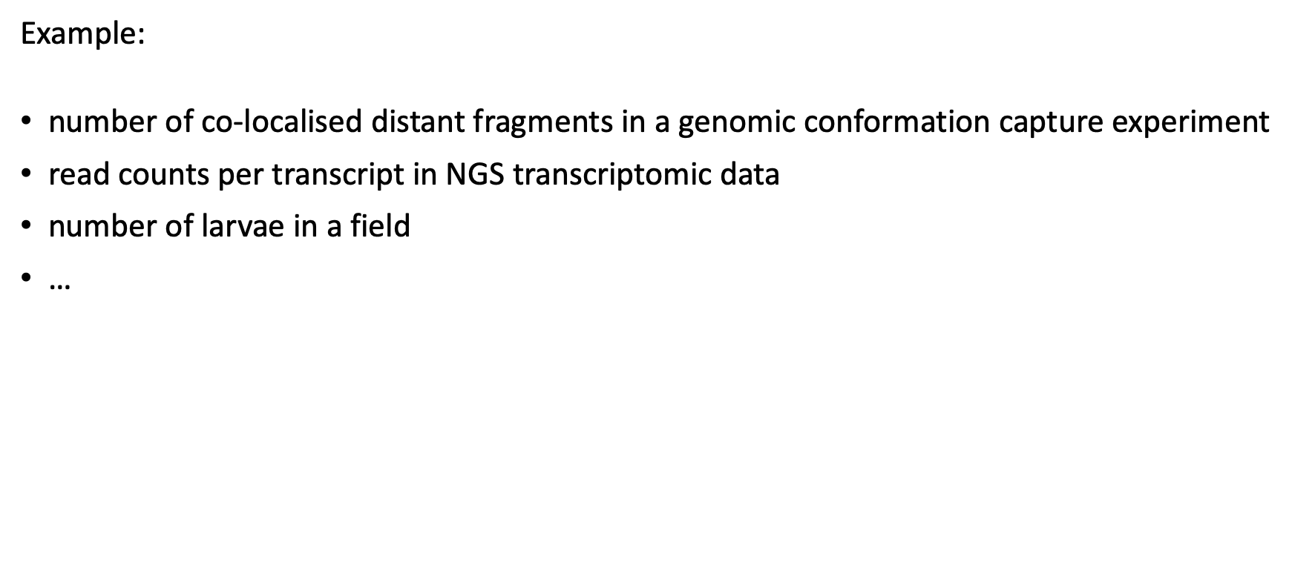
Common distributions: Negative binomial
Example:
number of co-localised distant fragments in a genomic conformation capture experiment
read counts per transcript in NGS transcriptomic data
number of larvae in a field
…

Slide 48
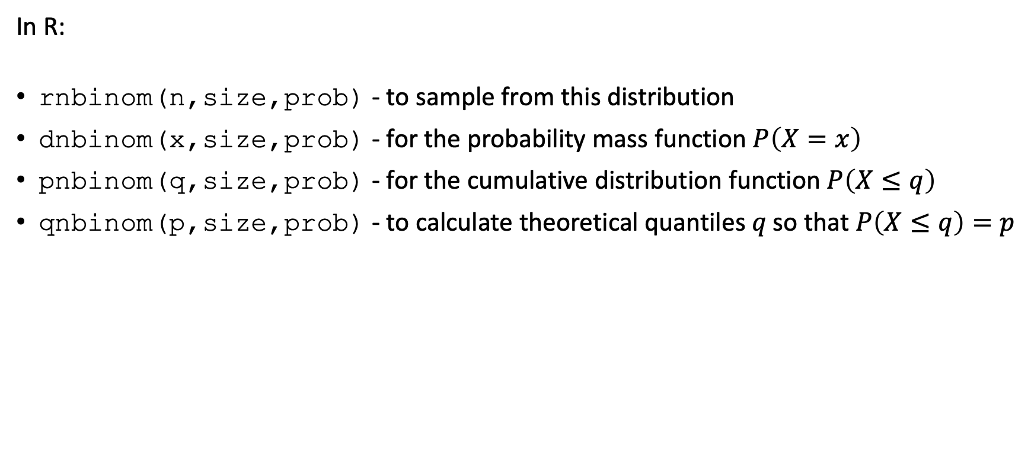
Common distributions: Negative binomial
In R:
rnbinom(n,size,prob) - to sample from this distribution
dnbinom(x,size,prob) - for the probability mass function $P\left(X=x\right)$
pnbinom(q,size,prob) - for the cumulative distribution function $P\left(X≤q\right)$
qnbinom(p,size,prob) - to calculate theoretical quantiles $q \text{so} \text{that} P\left(X≤q\right)=p$

Slide 49
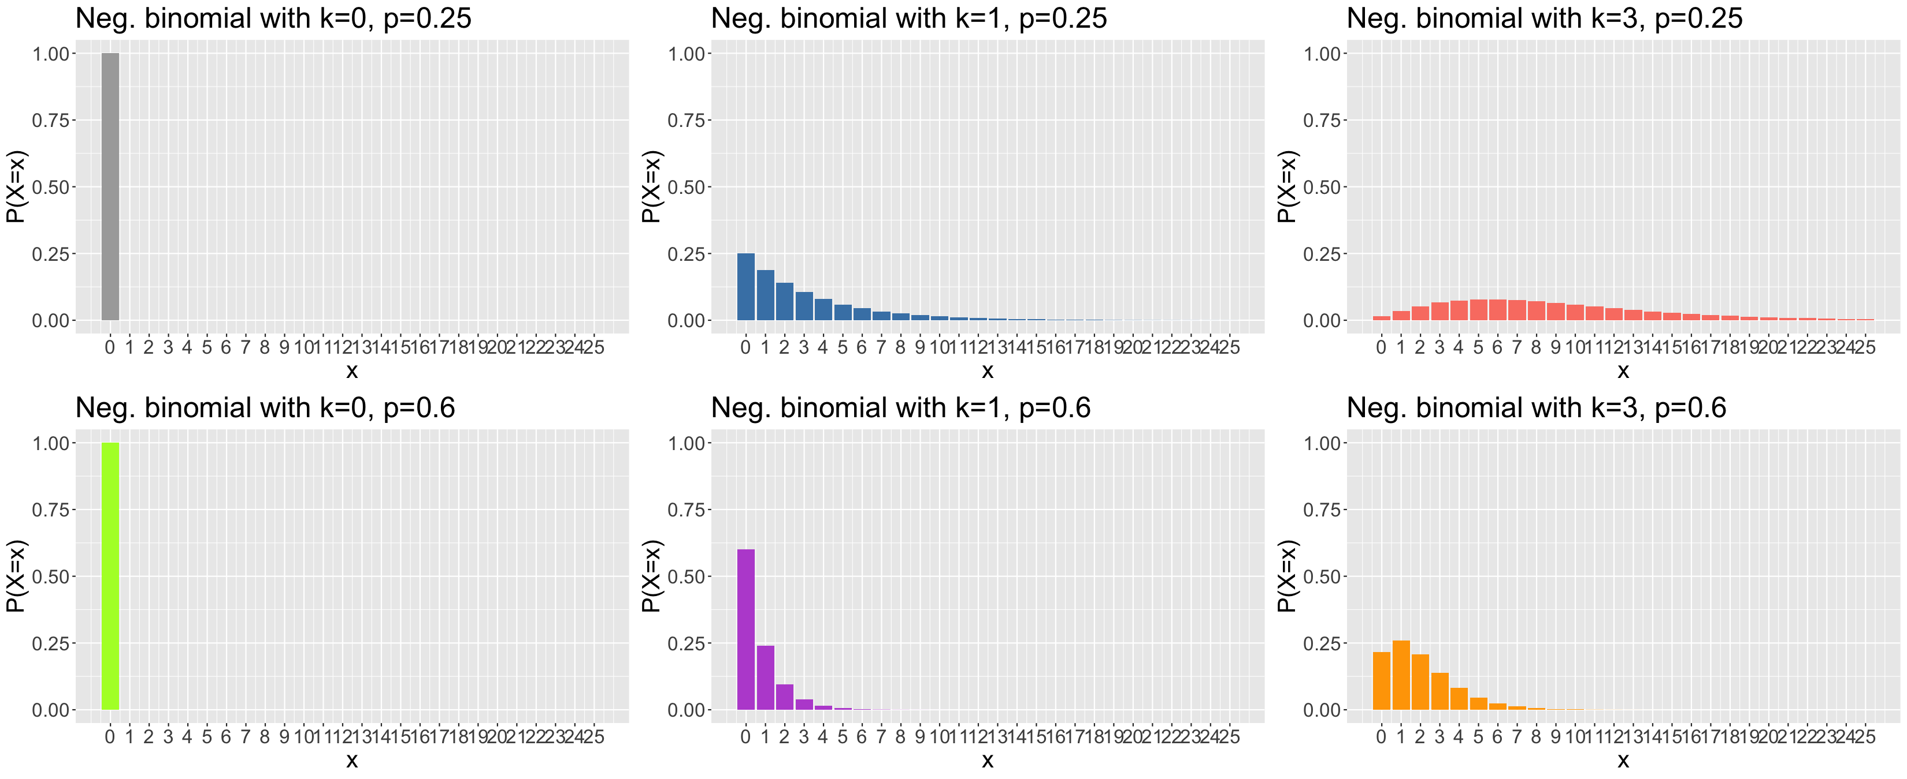
Common distributions: Negative binomial
plotNB<-function(k,p,col,maxK=25){ x<-seq(0,maxK,by=1) px<-dnbinom(x,size=k,prob=p) df<-tibble(x=x,px=px) g<-ggplot(data=df,mapping=aes(x=x,y=px)) + geom_bar(stat="identity",fill=col) + ylab("P(X=x)") + theme(text = element_text(size=20)) + ggtitle(paste(sep="","Neg. binomial with k=",k,", p=",p)) + scale_x_continuous(breaks=0:maxK) + coord_cartesian(xlim=c(-0.5,maxK+0.5),ylim=c(0,1)) return(g) } g1<-plotNB(0,0.25,"darkgrey"); g2<-plotNB(1,0.25,"steelblue") g3<-plotNB(3,0.25,"salmon"); g4<-plotNB(0,0.6,"greenyellow") g5<-plotNB(1,0.6,"mediumorchid"); g6<-plotNB(3,0.6,"orange") grid.arrange(g1,g2,g3,g4,g5,g6,ncol=3)

Slide 50
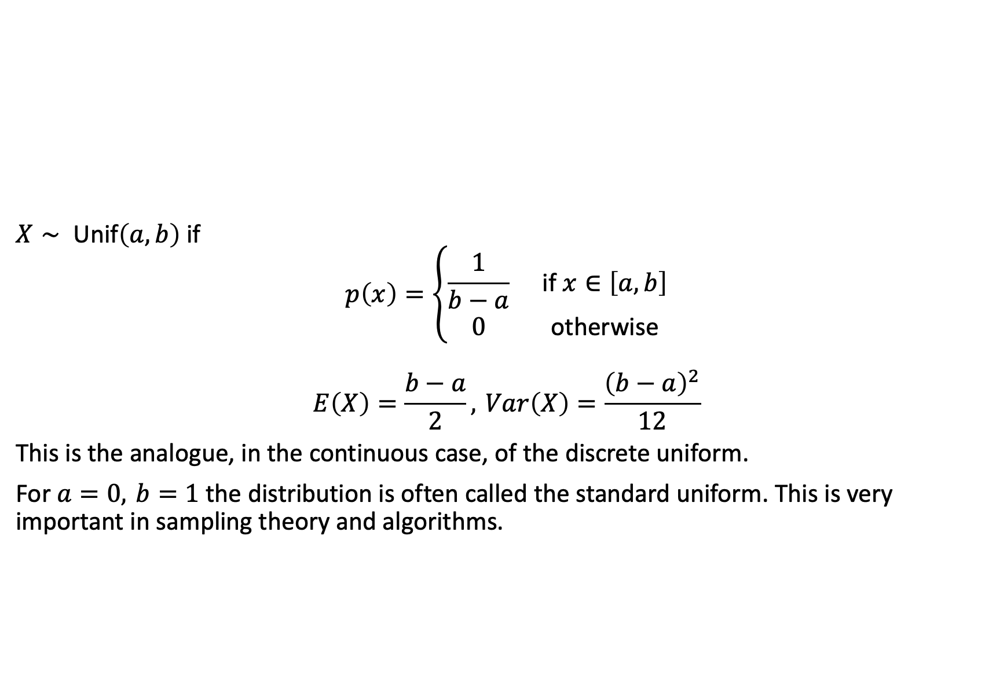
Common distributions: (Continuous) uniform
$X∼ \text{Unif}\left(a,b\right)$ if
$$p\left(x\right)=\left\{\begin{matrix}\frac{1}{b−a} & \text{if} x∈\left[a,b\right] \\ 0 & \text{otherwise}\end{matrix}\right.$$
$$E\left(X\right)=\frac{b−a}{2}, Var\left(X\right)=\frac{{\left(b−a\right)}^{2}}{12}$$
This is the analogue, in the continuous case, of the discrete uniform.
For $a=0, b=1$ the distribution is often called the standard uniform. This is very important in sampling theory and algorithms.

Slide 51
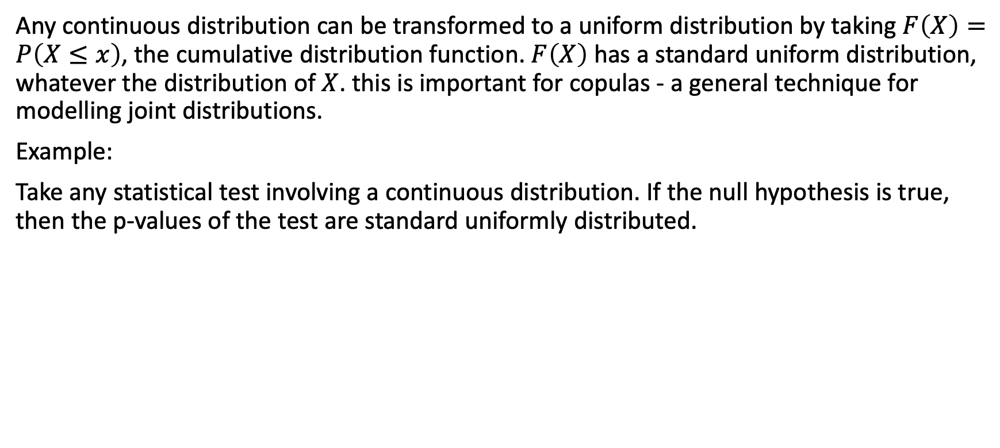
Common distributions: (Continuous) uniform
Any continuous distribution can be transformed to a uniform distribution by taking $F\left(X\right)=P\left(X≤x\right)$, the cumulative distribution function. $F\left(X\right)$ has a standard uniform distribution, whatever the distribution of $X$. this is important for copulas - a general technique for modelling joint distributions.
Example:
Take any statistical test involving a continuous distribution. If the null hypothesis is true, then the p-values of the test are standard uniformly distributed.

Slide 52
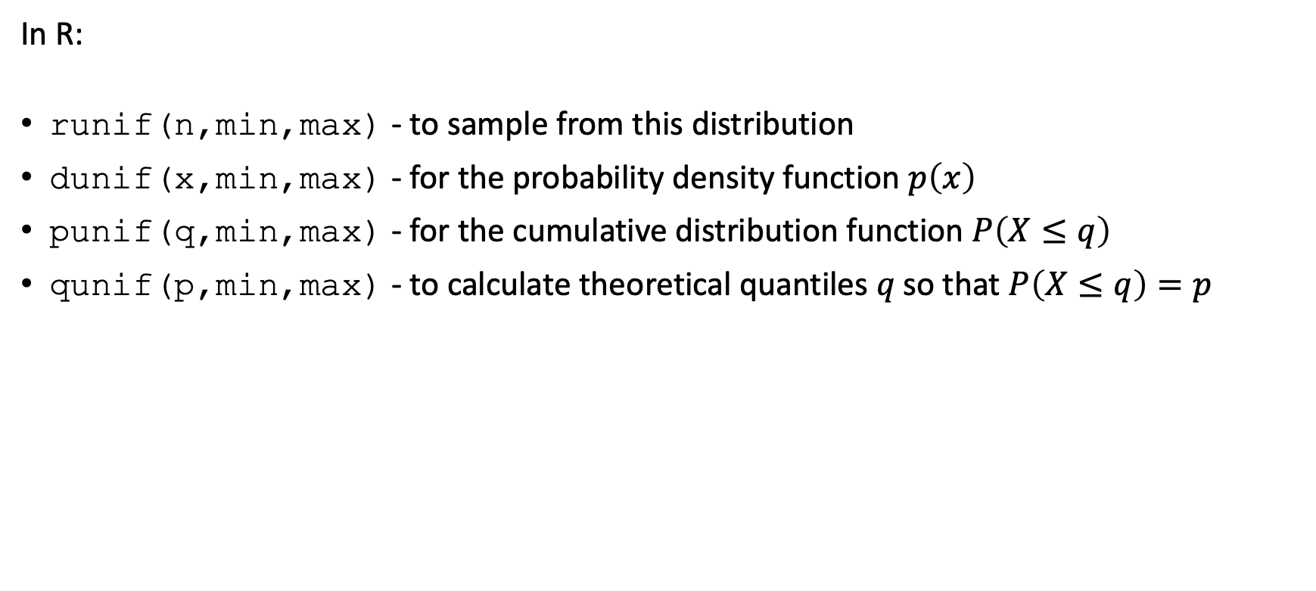
Common distributions: (Continuous) uniform
In R:
runif(n,min,max) - to sample from this distribution
dunif(x,min,max) - for the probability density function $p\left(x\right)$
punif(q,min,max) - for the cumulative distribution function $P\left(X≤q\right)$
qunif(p,min,max) - to calculate theoretical quantiles $q \text{so} \text{that} P\left(X≤q\right)=p$

Slide 53
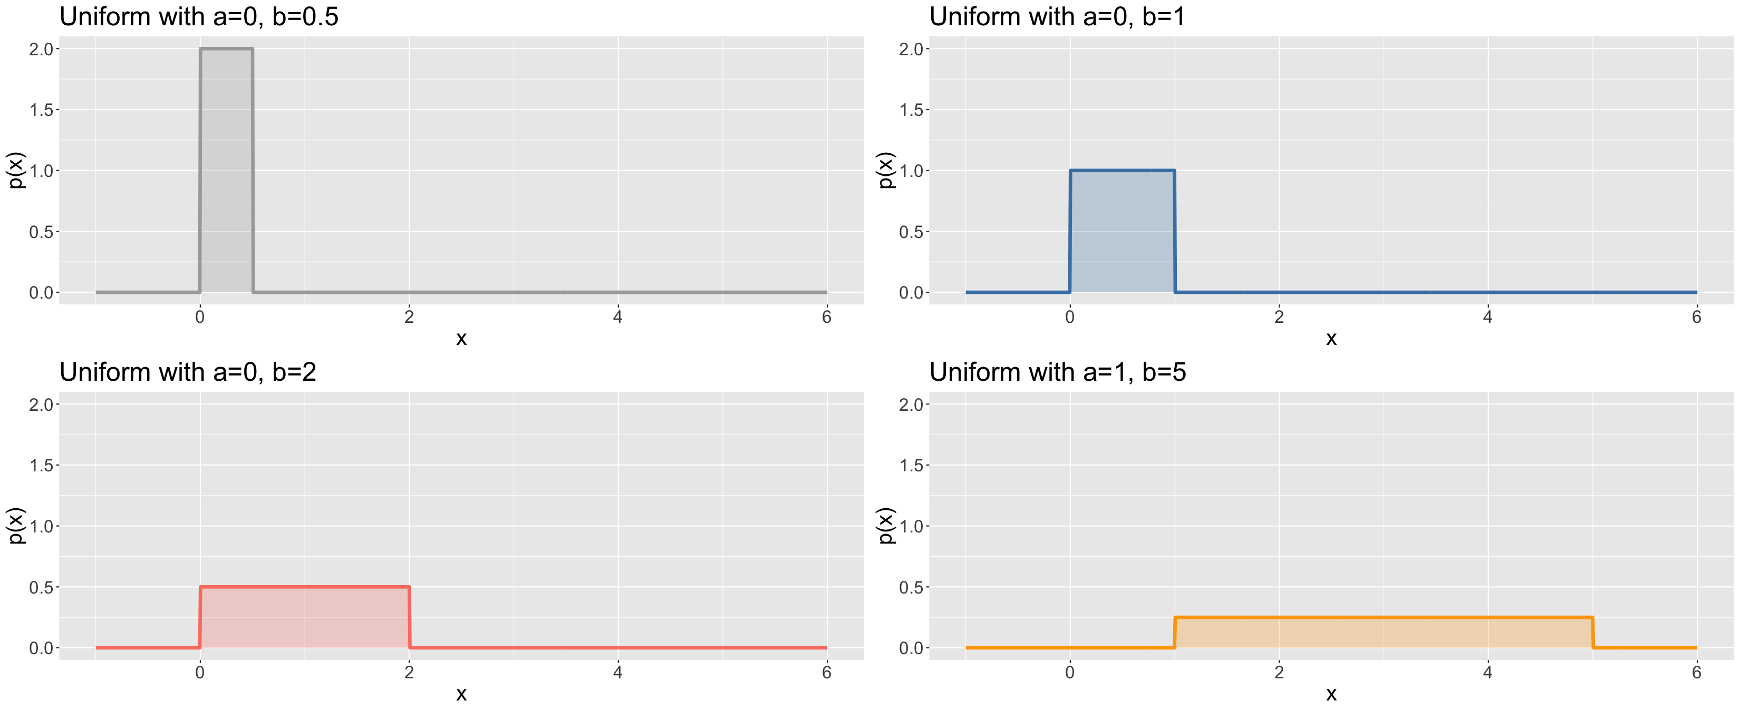
Common distributions: (Continuous) uniform
plotUnif<-function(a,b,col,plotRange=c(-1,6)){ x<-seq(plotRange[1],plotRange[2],length=1000) px<-dunif(x,min=a,max=b) df<-tibble(x=x,px=px) g<-ggplot(data=df,mapping=aes(x=x,y=px)) + geom_line(colour=col,lwd=1.5) + geom_area(fill=col,alpha=0.25) + ylab("p(x)") + theme(text = element_text(size=20)) + ggtitle(paste(sep="","Uniform with a=",a,", b=",b)) + coord_cartesian(xlim=plotRange,ylim=c(0,2)) return(g) } g1<-plotUnif(0,0.5,"darkgrey"); g2<-plotUnif(0,1,"steelblue") g3<-plotUnif(0,2,"salmon"); g4<-plotUnif(1,5,"orange") grid.arrange(g1,g2,g3,g4,ncol=2)

Slide 54
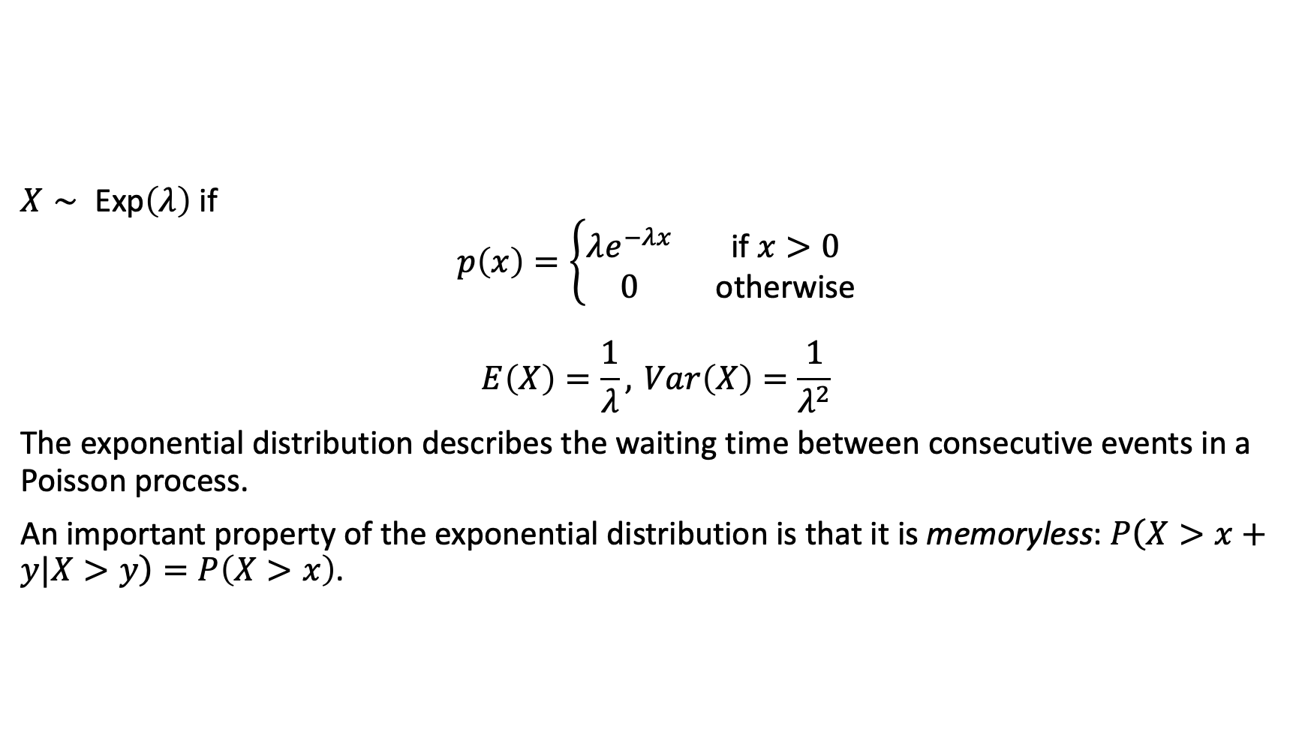
Common distributions: Exponential
$X∼ \text{Exp}\left(λ\right)$ if
$$p\left(x\right)=\left\{\begin{matrix}λe^{−λx} & \text{if} x>0 \\ 0 & \text{otherwise}\end{matrix}\right.$$
$$E\left(X\right)=\frac{1}{λ}, Var\left(X\right)=\frac{1}{λ^{2}}$$
The exponential distribution describes the waiting time between consecutive events in a Poisson process.
An important property of the exponential distribution is that it is memoryless: $P\left(X>x+y|X>y\right)=P\left(X>x\right)$.

Slide 55
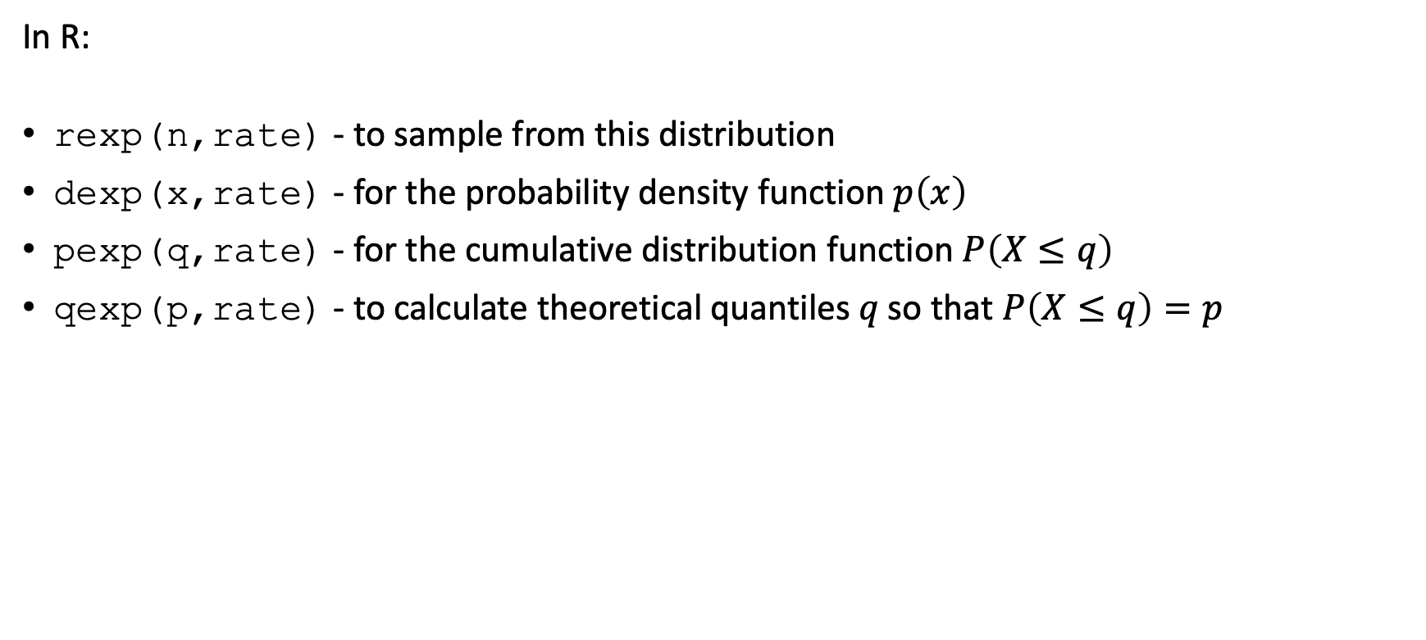
Common distributions: Exponential
In R:
rexp(n,rate) - to sample from this distribution
dexp(x,rate) - for the probability density function $p\left(x\right)$
pexp(q,rate) - for the cumulative distribution function $P\left(X≤q\right)$
qexp(p,rate) - to calculate theoretical quantiles $q \text{so} \text{that} P\left(X≤q\right)=p$

Slide 56
Common distributions: Exponential
As an exercise:
In a study where on average you screen 1 eligible patient every second day (and then recruit them), what is the probability of having to wait 5 or more days before you recruit a patient?

Slide 57
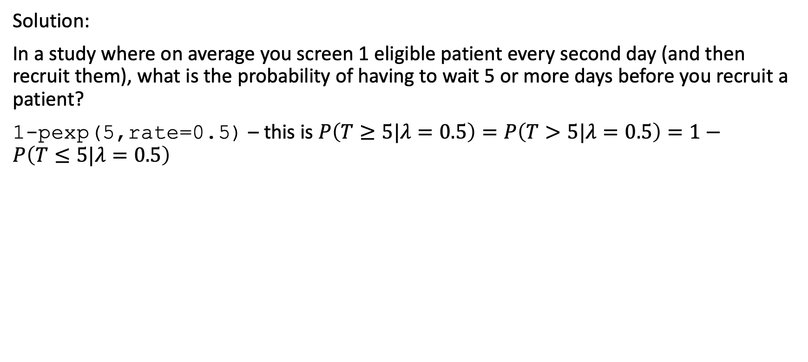
Common distributions: Exponential
Solution:
In a study where on average you screen 1 eligible patient every second day (and then recruit them), what is the probability of having to wait 5 or more days before you recruit a patient?
1-pexp(5,rate=0.5) – this is $P\left(T≥5|λ=0.5\right)=P\left(T>5|λ=0.5\right)=1−P\left(T≤5|λ=0.5\right)$

Slide 58
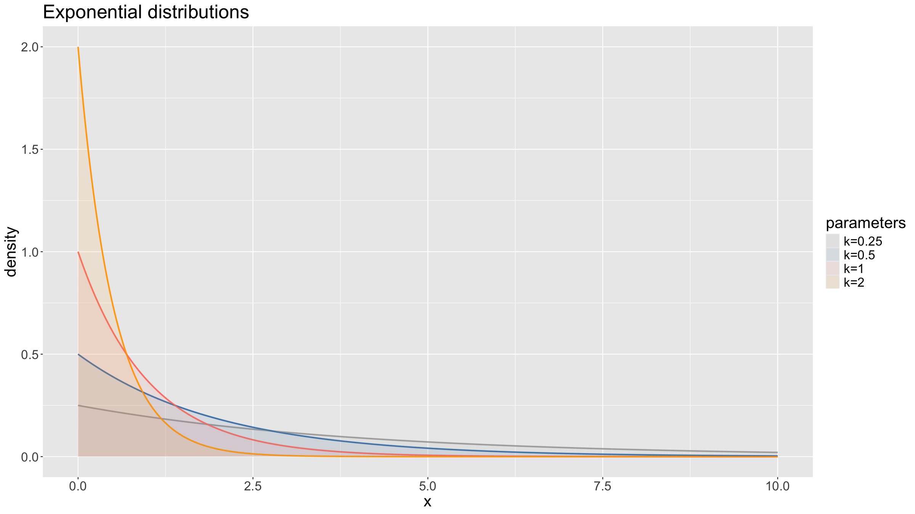
Common distributions: Exponential
l<-1000; x<-seq(0,10,length=l) p1x<-dexp(x,rate=0.25); p2x<-dexp(x,rate=0.5) p3x<-dexp(x,rate=1); p4x<-dexp(x,rate=2) xFull<-rep(x,4); pFull<-c(p1x,p2x,p3x,p4x) pars<-factor(c(rep(1,l),rep(2,l),rep(3,l),rep(4,l))) df<-tibble(x=xFull,p=pFull,pars=pars) cols<-c("darkgrey", "steelblue", "salmon", "orange") labs<-paste(sep="","k=",c(0.25,0.5,1,2)) ggplot(data=df,mapping=aes(x=x,y=p,colour=pars,fill=pars)) + geom_line(lwd=1,alpha=0.75) + geom_area(alpha=0.1,position="dodge") + scale_color_manual(values=cols) + scale_fill_manual(values=cols,labels=labs) + labs(fill="parameters") + guides(colour=F) + ylab("density") + ggtitle("Exponential distributions") + theme(text = element_text(size=20))

Slide 59
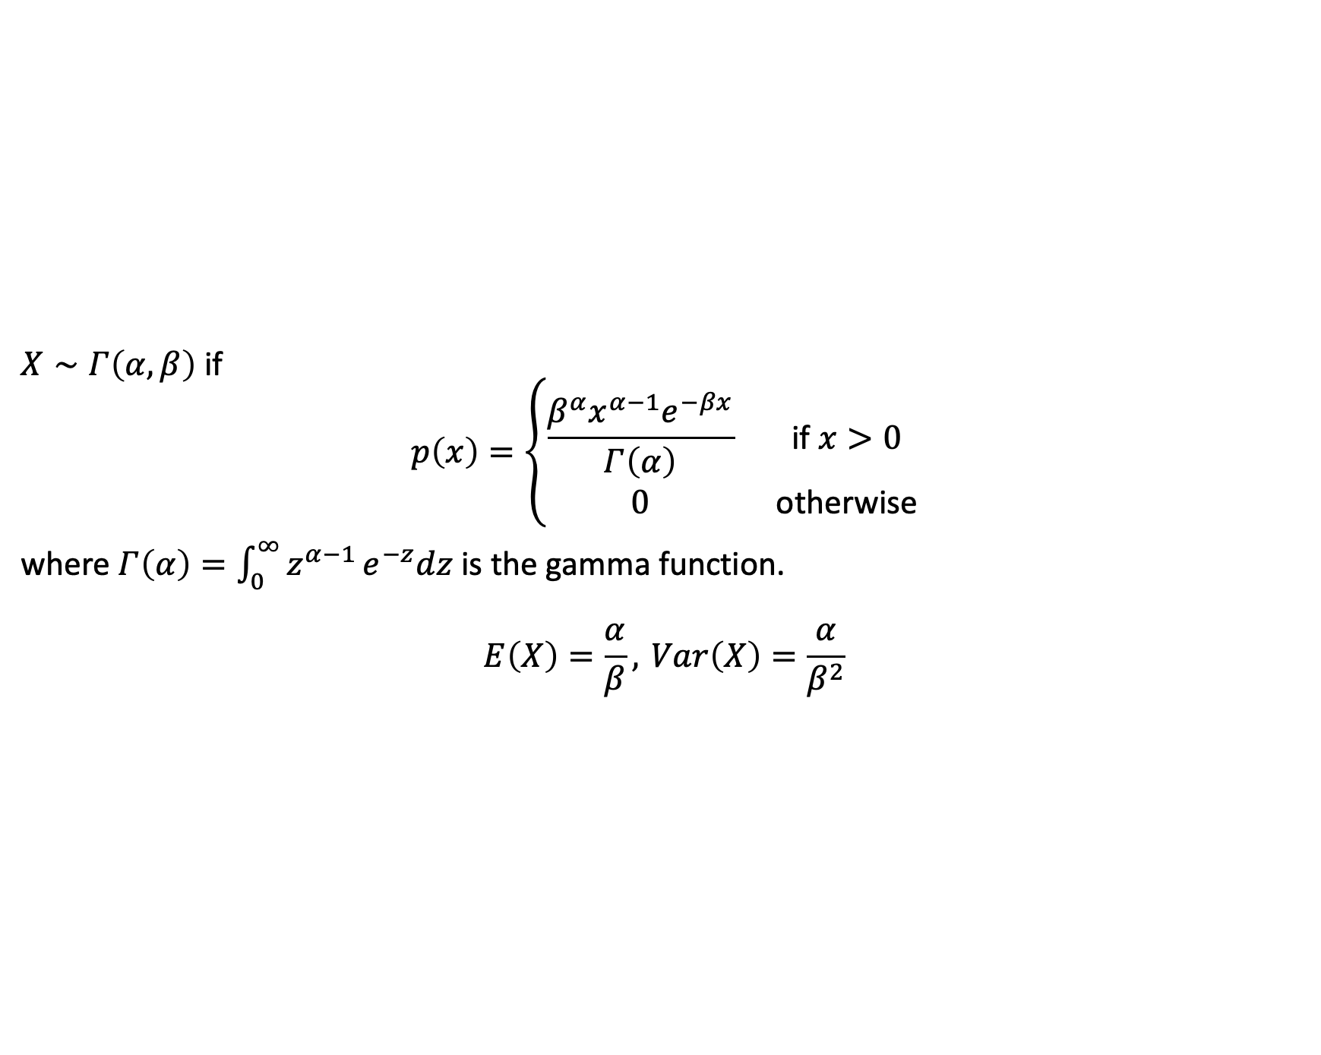
Common distributions: Gamma
$X∼Γ\left(α,β\right)$ if
$$p\left(x\right)=\left\{\begin{matrix}\frac{β^{α}x^{α−1}e^{−βx}}{Γ\left(α\right)} & \text{if} x>0 \\ 0 & \text{otherwise}\end{matrix}\right.$$
where $Γ\left(α\right)=\int_{0}^{∞}{z^{α−1}}e^{−z}dz$ is the gamma function.
$$E\left(X\right)=\frac{α}{β}, Var\left(X\right)=\frac{α}{β^{2}}$$

Slide 60

Common distributions: Gamma
The exponential distribution arises as a sum of independent exponentially distributed random variables.
It is an important conjugate prior distribution in Bayesian statistics.
Example:
Inter-spike intervals in neuroscience.

Slide 61

Common distributions: Gamma
In R:
rgamma(n,shape,rate) - to sample from this distribution
dgamma(x,shape,rate) - for the probability density function $p\left(x\right)$
pgamma(q,shape,rate) - for the cumulative distribution function $P\left(X≤q\right)$
qgamma(p,shape,rate) - to calculate theoretical quantiles $q \text{so} \text{that} P\left(X≤q\right)=p$

Slide 62
Common distributions: Gamma
l<-1000; x<-seq(0,20,length=l) p1x<-dgamma(x,shape=1,rate=0.5); p2x<-dgamma(x,shape=1,rate=2) p3x<-dgamma(x,shape=0.5,rate=1); p4x<-dgamma(x,shape=2,rate=1) p5x<-dgamma(x,shape=4,rate=1); p6x<-dgamma(x,shape=8,rate=1) xFull<-rep(x,6); pFull<-c(p1x,p2x,p3x,p4x,p5x,p6x) pars<-factor(c(rep(1,l),rep(2,l),rep(3,l),rep(4,l),rep(5,l),rep(6,l))) df<-tibble(x=xFull,p=pFull,pars=pars) cols<-c("darkgrey", "steelblue", "salmon", "orange", "greenyellow", "mediumorchid") labs<-c(expression(paste(sep="",alpha,"=1, ",beta,"=0.5")), expression(paste(sep="",alpha,"=1, ",beta,"=2")), expression(paste(sep="",alpha,"=0.5, ",beta,"=0.5")), expression(paste(sep="",alpha,"=2, ",beta,"=1")), expression(paste(sep="",alpha,"=4, ",beta,"=1")), expression(paste(sep="",alpha,"=8, ",beta,"=1")))

Slide 63

Common distributions: Gamma
ggplot(data=df,mapping=aes(x=x,y=p,colour=pars,fill=pars)) + geom_line(lwd=1,alpha=0.75) + geom_area(alpha=0.1,position="dodge") + scale_color_manual(values=cols) + scale_fill_manual(values=cols,labels=labs) + labs(fill="parameters") + guides(colour=F) + ylab("density") + ggtitle("Gamma distribution") + theme(text = element_text(size=20)) + coord_cartesian(ylim=c(0,1.5))

Slide 64

Common distributions: Beta
$X∼β\left(α,β\right)$ if
$$p\left(x\right)=\left\{\begin{matrix}\frac{x^{α−1}{\left(1−x\right)}^{β−1}}{B\left(α,β\right)} & \text{if} x∈\left[0,1\right] \\ 0 & \text{otherwise}\end{matrix}\right.$$
where $B\left(α,β\right)=\frac{Γ\left(α\right)Γ\left(β\right)}{Γ\left(α+β\right)}$
$$E\left(X\right)=\frac{α}{α+β}, Var\left(X\right)=\frac{αβ}{{\left(α+β\right)}^{2}\left(α+β+1\right)}$$

Slide 65

Common distributions: Beta
A flexible distribution useful to model continuous variables with support on an interval of finite length.
An important conjugate prior distribution in Bayesian statistics for a number of distributions involving probability parameters.

Slide 66

Common distributions: Beta
In R:
rbeta(n,shape1,shape2) - to sample from this distribution
dbeta(x,shape1,shape2) - for the probability density function $p\left(x\right)$
pbeta(q,shape1,shape2) - for the cumulative distribution function $P\left(X≤q\right)$
qbeta(p,shape1,shape2) - to calculate theoretical quantiles $q \text{so} \text{that} P\left(X≤q\right)=p$

Slide 67
Common distributions: Beta
l<-1000; x<-seq(0,1,length=l) p1x<-dbeta(x,shape1=0.5,shape2=0.5); p2x<-dbeta(x,shape1=1,shape2=1) p3x<-dbeta(x,shape1=2,shape2=2); p4x<-dbeta(x,shape1=1,shape2=3) p5x<-dbeta(x,shape1=2,shape2=5); p6x<-dbeta(x,shape1=5,shape2=1) xFull<-rep(x,6); pFull<-c(p1x,p2x,p3x,p4x,p5x,p6x) pars<-factor(c(rep(1,l),rep(2,l),rep(3,l),rep(4,l),rep(5,l),rep(6,l))) df<-tibble(x=xFull,p=pFull,pars=pars) cols<-c("darkgrey", "steelblue", "salmon", "orange", "greenyellow", "mediumorchid") labs<-c(expression(paste(sep="",alpha,"=0.5, ",beta,"=0.5")), expression(paste(sep="",alpha,"=1, ",beta,"=1")), expression(paste(sep="",alpha,"=2, ",beta,"=2")), expression(paste(sep="",alpha,"=1, ",beta,"=3")), expression(paste(sep="",alpha,"=2, ",beta,"=5")), expression(paste(sep="",alpha,"=5, ",beta,"=1")))

Slide 68

Common distributions: Beta
ggplot(data=df,mapping=aes(x=x,y=p,colour=pars,fill=pars)) + geom_line(lwd=1,alpha=0.75) + geom_area(alpha=0.1,position="dodge") + scale_color_manual(values=cols) + scale_fill_manual(values=cols,labels=labs) + labs(fill="parameters") + guides(colour=F) + ylab("density") + ggtitle("Beta distribution") + theme(text = element_text(size=20)) + coord_cartesian(ylim=c(0,3))

Slide 69

Common distributions: Normal / Gaussian
$X∼𝒩\left(μ,σ^{2}\right)$ if
$$p\left(x\right)=\frac{1}{\sqrt{2πσ^{2}}}e^{−\frac{{\left(x−μ\right)}^{2}}{2σ^{2}}}$$
$$E\left(X\right)=μ, Var\left(X\right)=σ^{2}$$
This distribution is very important.
Because of the Central Limit Theorem, the normal distribution both arises in many real life situations and plays a major role in statistical inference.

Slide 70

Common distributions: Normal / Gaussian
The normal distribution is characterised by a symmetric bell-shaped curve around the mean.
Important special case: $𝒩\left(0,1\right)$, the standard normal.
Example:
A random variable measuring the height of men.

Slide 71

Common distributions: Normal / Gaussian
In R:
rnorm(n,mean,sd) - to sample from this distribution
dnorm(x,mean,sd) - for the probability density function $p\left(x\right)$
pnorm(q,mean,sd) - for the cumulative distribution function $P\left(X≤q\right)$
qnorm(p,mena,sd) - to calculate theoretical quantiles $q \text{so} \text{that} P\left(X≤q\right)=p$

Slide 72

Common distributions: Normal / Gaussian
As an exercise:
As we will see later, a sample mean $\overset{‾}{X}$ calculated over a large enough sample size, will be approximately normally distributed, with standard deviation equal to the standard error. Suppose you have conducted a study with 522 participants, measuring the height of each of them. You have calculated a sample mean of 171cm with a standard error of 0.2cm. What is the probability of the true population mean to be less than 168cm?

Slide 73

Common distributions: Normal / Gaussian
Solution:
As we will see later, a sample mean $\overset{‾}{X}$ calculated over a large enough sample size, will be approximately normally distributed, with standard deviation equal to the standard error. Suppose you have conducted a study with 522 participants, measuring the height of each of them. You have calculated a sample mean of 171cm with a standard error of 0.2cm. What is the probability of the true population mean to be less than 168cm?
Our estimate for the population mean $μ$ is the observed sample mean $\overset{‾}{x}$. The estimator for the sample mean, $\overset{‾}{X}$, has an approximate $𝒩\left(171,0.2\right)$ distribution and hence to compute $P\left(\overset{‾}{X}<168\right)$. In R this is pnorm(168,mean=171,sd=0.2). The probability for this is $p=3.67⋅{10}^{−51}$ – extremely unlikely.

Slide 74
Common distributions: Normal / Gaussian
l<-1000; x<-seq(-5,5,length=l) p1x<-dnorm(x,mean=0,sd=1); p2x<-dnorm(x,mean=0,sd=2) p3x<-dnorm(x,mean=0,sd=0.5); p4x<-dnorm(x,mean=2,sd=1) xFull<-rep(x,4); pFull<-c(p1x,p2x,p3x,p4x) pars<-factor(c(rep(1,l),rep(2,l),rep(3,l),rep(4,l))) df<-tibble(x=xFull,p=pFull,pars=pars) cols<-c("darkgrey", "steelblue", "salmon", "orange") labs<-c(expression(paste(sep="",mu,"=0, ",sigma,"=1")), expression(paste(sep="",mu,"=0, ",sigma,"=2")), expression(paste(sep="",mu,"=0, ",sigma,"=0.5")), expression(paste(sep="",mu,"=2, ",sigma,"=1")))

Slide 75

Common distributions: Normal / Gaussian
ggplot(data=df,mapping=aes(x=x,y=p,colour=pars,fill=pars)) + geom_line(lwd=1,alpha=0.75) + geom_area(alpha=0.25,position="dodge") + scale_color_manual(values=cols) + scale_fill_manual(values=cols,labels=labs) + labs(fill="parameters") + guides(colour=F) + ylab("density") + ggtitle("Normal distribution") + theme(text = element_text(size=20))

Slide 76


Common distributions: Normal / Gaussian
Carl Friedrich Gauss (public domain / Wikipedia)
Pierre Simon Laplace (public domain / Wikipedia)

Slide 77

Common distributions: relationships
Relationships between common distributions. (Casella, G., Berger, R.L. (2002), Statistical Inference, 2nd ed., Duxbury)

Slide 78
Common distributions
Exercise:
What distribution could be useful to describe study participants’ incomes?
What distribution could be appropriate when you study in-hospital survival of study participants?
What distribution could be appropriate when you collect data on the number of sexual partners of study participants?
What distribution could be used to model the time it takes patients to present to hospital?

Slide 79

Central Limit Theorem

Slide 80
Sampling distributions
Almost all of the studies you will work on will consist of drawing one (or several) samples that permits you to make inferences about a population (or several) of interest.
How you sample from your population will impact your analysis. Objective assessment can only be made for probability samples, i.e. for samples where the inclusion probability is known and positive for every unit in the target population. In a simple random sample all units are sampled with equal probability from the target population.
For every unit in the sample you observe one or several variables. In probability samples, these can be viewed as random variables.

Slide 81

Sampling distributions
Usually we are not interested in the individual outcomes of the sample, but rather in some sample statistic. A statistic is a function of the sample observations $X_{i}$ and is therefore itself a random variable.
Examples
the sample mean $\overset{‾}{X}=\frac{1}{n}\sum_{i=1}^{n}{X_{i}}$ (sample fraction if $X_{i}$ binary)
the sample variance $S^{2}=\frac{1}{n−1}\sum_{i=1}^{n}{{\left(X_{i}−\overset{‾}{X}\right)}^{2}}$

Slide 82

Sampling distributions
The probability distribution of a sample statistic is called its sampling distribution.
In practice it can be hard to derive the sampling distribution analytically and we need to rely on approximations of this distribution based on so-called asymptotic results.
The most important of these results is the Central Limit Theorem.

Slide 83

Law of Large Numbers
Let $X_{1},...,X_{n}$ be a sequence of iid random variables, with $X_{i}∼F$, where F is a distribution with some finite mean $μ$ and a finite variance $σ^{2}$. Let ${\overset{‾}{X}}_{n}=\frac{1}{n}\sum_{i=1}^{n}{X_{i}}$ be the sample average.
The Law of Large Numbers (LLN) states that as $n→∞$, ${\overset{‾}{X}}_{n}→μ$
Note that there is a strong and a weak version of this law, depending on what exactly you mean by “$→$” and they differ slightly in necessary conditions for them to hold.

Slide 84

Central Limit Theorem
While the LLN states that a sample average will get closer and closer to the true mean as the number of samples increases, fluctuating ever more closely around this value, the Central Limit Theorem (CLT) goes a step further and describes the distribution of these fluctuations.
Let $X_{1},...,X_{n}$ a sequence of iid random variables, $X_{i}∼F$ a distribution with finite mean $μ$ and finite variance $σ^{2}$. Then
$$\frac{\overset{‾}{X}−μ}{σ/\sqrt{n}}\overset{D}{→}𝒩\left(0,1\right)$$
where $\overset{D}{→}$ denotes convergence in distribution.

Slide 85

Central Limit Theorem
Crucially, since $\overset{‾}{X}=\frac{1}{n}\sum_{i}^{​}{X_{i}}$, this implies that any large enough sum of iid random variables approximately follows a normal distribution:
$$\sum_{i}^{​}{X_{i}}\overset{D}{→}𝒩\left(nμ,nσ^{2}\right)$$

Slide 86

Central Limit Theorem
The CLT is central / key in statistics because:
Any statistic that is a sum of enough random variables with similar distributions will be approximately normally distributed.
The normal distribution can be used to approximate the sampling distributions of many statistics, and the statistical theory for the normal distribution can be used to derive properties.
Examples
Normal approximation to the binomial.
t test robust against deviations from normality.
Height distributions of humans.

Slide 87
Central Limit Theorem
generateMeans<-function(n=c(1,2,5,10,50,100,500,1000),col=cols,N=1e4,rDistFun,xlim=NULL,...){ sim<-matrix(nrow=N,ncol=length(n)) for(j in 1:length(n)){for(i in 1:N){ sim[i,j]<-mean(rDistFun(n[j],...)) }} par(mar=c(1.5,2.5,1.5,0.5),mfrow=c(length(n),1)) for(j in 1:length(n)){ if(length(xlim)<2){ hist(breaks=100,sim[,j],main=paste(sep="","n = ",n[j]),yaxt="n",col=col[j]) }else{ hist(breaks=100,sim[,j],main=paste(sep="","n = ",n[j]),xlim=xlim,yaxt="n",col=col[j]) } } }

Slide 88

Central Limit Theorem
Or use this simple shiny app: https://mlw-stats.shinyapps.io/DemonstrateTheCLT

Slide 89

Central Limit Theorem
generateMeans(rDistFun=rnorm,xlim=c(-3,3))

Slide 90

Central Limit Theorem
generateMeans(rDistFun=rbeta,shape1=0.5,shape2=0.5,xlim=c(0,1))

Slide 91

Central Limit Theorem
generateMeans(rDistFun=rbinom,size=2,prob=0.25,xlim=c(0,2))

Slide 92
Study designs (primer)

Slide 93
Study question
Any study starts with a hypothesis which in turn is used to define one or several study question(s).
The study question determines what design is needed or optimal to answer the question.
(Medical) research questions should follow the PICOT mnemonic:
Population - who do you need to study?
Intervention (if applicable) - what treatment are you investigating?
Comparison - which groups / exposures are you comparing, what is the control?
Outcome - what are you planning to measure?
Time - over what duration will you collect data?
The study design will determine what analytical approaches are appropriate.

Slide 94
Observational studies: Cross-sectional studies
The study is conducted once in a defined population at a specific point in time.
Get a snapshot of variables of interest (e.g. frequency of an exposure or prevalence of an outcome) for study population at that point in time.
Can be descriptive or analytical (e.g. if frequency of outcome is compared according to exposure status).

Slide 95
Observational studies: Cohort studies
Key steps:
Recruit from study population at a specific point in time, but then follow this group / cohort over time.
Usually individuals already with the outcome of interest are excluded from recruitment.
Observe outcome(s) of interest as they occur.
Can be prospective or retrospective.
Can be descriptive or analytical (e.g. if frequency of outcome is compared according to exposure status).

Slide 96
Observational studies: Case-control study
Recruit individuals with a specific outcome of interest (cases).
Recruit from a representative group of individuals without the outcome (controls).
Compare cases and controls to assess differences in past exposures or personal characteristics to identify one or more risk factors.

Slide 97
Interventional and experimental studies
Rather than observing exposures and outcomes, researcher is in control of exposure:
Allocate (typically randomly) exposure (the intervention) to one group.
Another group allocated to no intervention (control or standard of care).
Follow the groups up over time.
Compare outcome(s) of interest in the intervention and control groups.
Can have more than one intervention arm.

Slide 98
Types of interventional studies
Randomised controlled trial (gold standard)
Randomised means allocation to the groups is random (note that random allocation is not the same as random sampling)
Controlled means one group receives the intervention while another does not
Trial means experiment or study
Randomisation can be at individual or group / cluster (e.g. households, schools, health centres, …) level (cluster randomised trials; CRTs)
CRTs require special sample size and analysis methods
Quasi-experimental design: no (full) randomization
Before - after designs.
Stepped wedge designs.

Slide 99
Quick note on ethics in RCTs
Recall that an RCT is similar to a cohort (observational) study.
Differs because RCT allocates the exposure (intervention) rather than observing a naturally occurring exposure.
Investigator cannot allocate a harmful or withhold a beneficial intervention.
Equipoise means that there is no evidence that one of the interventions is superior to the other.

Slide 100
Advanced intervention study designs
Factorial designs
Multiple interventions tested in a single study without having to increase the number of study arms
e.g. 2x2 with 2 interventions A, B and a control (C) group; comparisons are 1) A+B and A only vs B only and C and 2) A+B and B only vs A only and C
ZAMSTAR trial (Ayles et al Lancet 2013)
Assume that the interventions are independent of each other; not powered to test this key assumption
Adaptive / master protocol designs e.g. seamless multi-arm multi-stage (MAMS) design
Multi-arm, multi-stage (MAMS) designs
Platform (ongoing addition/removal of arms and /or participants), basket (one intervention, many diseases) and umbrella (multiple interventions, one disease) trials
PASTAL trial (Choko et al Trials 2017)
Package of interventions compared to a simple standard of care
LINK4HEALTH trial in Swaziland (McNairy et al PLoS Med 2017)

Slide 101
Target trial emulation
Sometimes it is unethical to run a trial and you can only plan an observational study. Or you may have observational data but analyse them as if an exposure had been randomised between participants.
In this case, causal inference methods can bridge the gap (somewhat).
In particular target trial emulation is gaining rapidly in popularity:
Attempts to make groups receiving an intervention or not as comparable as possible (i.e. as if they had been randomised to) by accounting for how likely individuals were to have received the intervention. Most typically this involves weighting observations differently through using e.g. propsenisty scoring, overlap weighting, …
You emulate rather than just observe data. However, you need to formally define each step as in a trial: eligibility criteria, treatment arms, adherence criteria, randomisation (this will be emulated), baseline timepoint, follow-up timepoint(s), clearly defined outcomes. You also need to define the (causal) estimand clearly.
See Hernán & Robins (2016); DOI 10.1093/aje/kwv254

Slide 102

Field experimental designs (FEDs)
These designs are for agricultural, vector biology and laboratory based studies.
These assume you have a number of experimental units that you can assign treatments to, but you cannot change the location of these units, but might be able to group / block them somehow (e.g. wells on a plate or plots within a field that are arranged in rows and columns).

Slide 103
FEDs: Completely Randomized Design (CRD)
Used to study the effect of one factor - does not take into account any extraneous source of variation.
N units and m different treatments.
Treatments are assigned to experimental units at random.
Experimental units are relatively homogeneous.
Experiment will use very few replicates.
Each treatment is replicated the same number of times (balanced design).

Slide 104
FEDs: Completely Randomized Design (CRD)
Mostly, focus is on the following:
Are there treatment differences betwen the different experimental units - comparison of means
Which of the units differ?
Advantages
Easy to implement
Controls a single extraneous source of variation.
Removes its effect from the estimate of experimental error.
Disdvantages
Experimental units are rarely homogeneous to allow for effective application of the CRD.

Slide 105
FEDs: Randomized Complete Block Design
The field is divided into units to account for any variation in the field (e.g. one part of the field is closer to a water source or gets more sun, …).
Units within the block are homogeneous.
Experiment with m treatments.
Treatments are then assigned at random to the subjects in the blocks - once in each block.
Provides more accurate results compared to the CRD due to the blocking.

Slide 106

FEDs: Randomized Complete Block Design
RCBD - 4 blocks and 4 treatments

Slide 107
FEDs: Latin square design
Extends RCBD to 2 blocking factors.
Experiment with m treatments.
Advantages:
Reduces experimental error more than with 1 blocking factor.
Small-scale studies can isolate important treatment effects.

Slide 108

FEDs: Latin square design
Latin square design

Slide 109
FEDs: Other designs
Factorial designs
Split-plot design
Graeco - Latin square
…

Slide 110
[end of Session 3]

